Slide 1
MongoDB
1

Slide 2
MongoDB (from "humongous") is a cross-platform document-oriented database. Classified as a NoSQL database, MongoDB.
Released under a combination of the GNU Affero General Public License and the Apache License, MongoDB is free and open-source software.
First developed by the software company 10gen (now MongoDB Inc.) in October 2007 as a component of a planned platform as a service product, the company shifted to an open source development model in 2009, with 10gen offering commercial support and other services.
Since then, MongoDB has been adopted as backend software by a number of major websites and services, including eBay, Foursquare, SourceForge, Viacom.
MongoDB is the most popular NoSQL database system.
2

Slide 3
JSON stands for JavaScript Object Notation.
This format was specified by Douglas Crockford.
This was designed for human-readable data interchange
It has been extended from the JavaScript scripting language.
The filename extension is .json
JSON is a text format that is completely language independent but uses conventions that are familiar to programmers of the C-family of languages, including C, C++, C#, Java, JavaScript, Perl, Python, and many others.
These properties make JSON an ideal data-interchange language.
3

Slide 4
JSON is built on two structures:
A collection of name/value pairs. In various languages, this is realized as an object, record,, dictionary, hash table, keyed list, or associative array.
An ordered list of values. In most languages, this is realized as an array, vector, list, or sequence.
4

Slide 5
JSON is used primarily to transmit data between a server and web application, as an alternative to XML.
Although originally derived from the JavaScript scripting language, JSON is a language-independent data format, and code for parsing.
Generating JSON data is readily available in a large variety of programming languages.
Following JSON syntax defines an employees object, with an array of 2 employee records (objects):
{"employees":[ {"firstName":"Anna", "lastName":"Smith"}, {"firstName":"Peter", "lastName":"Jones"} ] }
5

Slide 6
Uses of JSON
It is used while writing JavaScript based application which includes browser extension and websites.
JSON format is used for serializing & transmitting structured data over network connection.
This is primarily used to transmit data between server and web application.
Characteristics of JSON
Easy to read and write JSON.
Language independent.
6

Slide 7
Following example shows Books information stored using JSON considering language of books and there editions:
{ "book": [
{ "id":01,
"language": "Java",
"edition": "third",
"author": "Herbert Schildt”
},
{ "id":07,
"language": "C++",
"edition": "second”,
"author": "E.Balagurusamy"
}
]
}
7

Slide 8
Following datatypes are supported by JSON format:
Type | Description
Number | double- precision floating-point format in JavaScript
String | double-quoted Unicode with backslash escaping
Boolean | true or false
Array | an ordered sequence of values
Value | it can be a string, a number, true or false, null etc
Object | an unordered collection of key:value pairs
Whitespace | can be used between any pair of tokens
null | empty
8

Slide 9
Number
It is a double precision floating-point format in JavaScript and it depends on implementation.
Octal and hexadecimal formats are not used.
No NaN (not a number) or Infinity is used in Number.
Type | Description
Integer | Digits 1-9, 0 and positive or negative
Fraction | Fractions like .3, .9
Exponent | Exponent like e, e+, e-,E, E+, E-
9

Slide 10
SYNTAX:
var json-object-name = { string : number_value, .......}
EXAMPLE:
Example showing Number Datatype, value should not be quoted:
var obj = {marks: 97}
String
It is a sequence of zero or more double quoted Unicode characters with backslash escaping.
Character is a single character string i.e. a string with length 1.
10

Slide 11
The following table shows string types −
Type | Description
" | double quotation
\ | reverse solidus
/ | solidus
b | backspace
f | form feed
n | new line
r | carriage return
t | horizontal tab
u | four hexadecimal digits
11

Slide 12
SYNTAX:
var json-object-name = { string : "string value", .......}
EXAMPLE:
Example showing String Datatype:
var obj = {name: 'Amit'}
Boolean
It includes true or false values.
SYNTAX:
var json-object-name = { string : true/false, .......}
EXAMPLE:
var obj = {name: 'Amit', marks: 97, distinction: true}
12

Slide 13
Array
It is an ordered collection of values.
These are enclosed square brackets which means that array begins with .[. and ends with .]..
The values are separated by ,(comma).
Array indexing can be started at 0 or 1.
Arrays should be used when the key names are sequential integers.
SYNTAX:
[ value, .......]
EXAMPLE:
Example showing array containing multiple objects:
{ "books": [ { "language":"Java" , "edition":"second" },
{ "language":"C++" , " edition":"fifth" },
{ "language":"C" , "edition ":"third" }
]
}
13

Slide 14
Object
It is an unordered set of name/value pairs.
Object are enclosed in curly braces that is it starts with '{' and ends with '}'.
Each name is followed by ':'(colon) and the name/value pairs are separated by , (comma).
The keys must be strings and should be different from each other.
SYNTAX:
{ string : value, .......}
EXAMPLE:
Example showing Object:
{
"id": "011A",
"language": "JAVA",
"price": 500,
}
14

Slide 15
Whitespace
It can be inserted between any pair of tokens. It can be added to make code more readable. Example shows declaration with whitespace:
SYNTAX:
{string:" ",....}
EXAMPLE:
var i= " Rohan";
var j = " Harsh”;
null
It means empty type.
SYNTAX:
Null
EXAMPLE:
var i = null;
if(i==1)
{
document.write("<h1>value is 1</h1>");
}
else { document.write("<h1>value is null</h1>");
}
15

Slide 16
JSON Value
It includes:
number (integer or floating point)
string
boolean
array
object
null
SYNTAX:
String | Number | Object | Array | TRUE | FALSE | NULL
EXAMPLE:
var i =1;
var j = “Rohan";
var k = null;
16

Slide 17
A possible JSON representation describing a person.
{ "firstName": "John",
"lastName": "Smith",
"isAlive": true,
"age": 25,
"height_cm": 167.6,
"address":
{ "streetAddress": "21 2nd Street",
"city": "New York",
"state": "NY",
"postalCode": "10021-3100"
},
"phoneNumbers":
[ { "type": "home", "number": "212 555-1234" },
{ "type“:"office", "number": "646 555-4567" }
]
}
17

Slide 18
This XML syntax also defines an employees object with 3 employee records:
XML Example
<employees> <employee> <firstName>John</firstName> <lastName>Doe</lastName> </employee> <employee> <firstName>Anna</firstName> <lastName>Smith</lastName> </employee> <employee> <firstName>Peter</firstName> <lastName>Jones</lastName> </employee> </employees>
18

Slide 19
Example
JSON
{ "company": “Volkswagen”,
"name": "Vento",
"price": 800000
}
XML
<car>
<company>Volkswagen</company> <name>Vento</name>
<price>800000</price>
</car>
19

Slide 20
MongoDB
MongoDB is a cross-platform, document oriented database that provides, high performance, high availability, and easy scalability. MongoDB works on concept of collection and document.
20

Slide 21
Database -Database is a physical container for collections. Each database gets its own set of files on the file system. A single MongoDB server typically has multiple databases.
Collection-Collection is a group of MongoDB documents. It is the equivalent of an RDBMS table. A collection exists within a single database. Collections do not enforce a schema. Documents within a collection can have different fields. Typically, all documents in a collection are of similar or related purpose.
21

Slide 22
Document
A record in MongoDB is a document, which is a data structure composed of field and value pairs. MongoDB documents are similar to JSON objects.
The values of fields may include other documents, arrays, and arrays of documents.
A document is a set of key-value pairs. Documents have dynamic schema.
Dynamic schema means that documents in the same collection do not need to have the same set of fields or structure, and common fields in a collection's documents may hold different types of data.
22

Slide 23
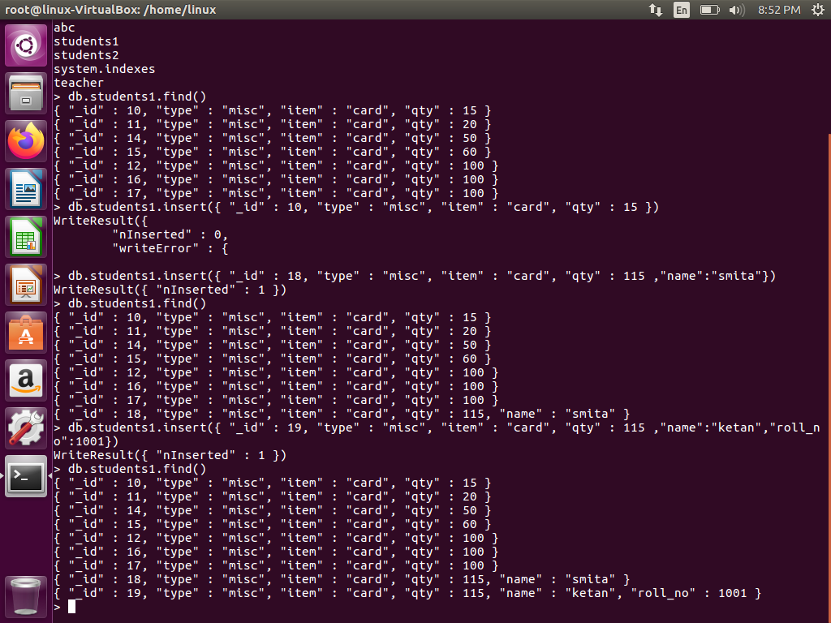
23

Slide 24
The advantages of using documents are:
Documents (i.e. objects) correspond to native data types in many programming languages.
Embedded documents and arrays reduce need for expensive joins.
24

Slide 25
The relationship of RDBMS terminology with MongoDB.
RDBMS | MongoDB
Database | Database
Table | Collection
Tuple/Row | Document
Column | Field
Table Join | Embedded Documents
Primary Key | Primary Key (Default key _id provided by mongodb itself)
25

Slide 26
Database Server and Client
Mysqld/Oracle | mongod
mysql/sqlplus | mongo
26

Slide 27
Features
High Performance
MongoDB provides high performance data persistence. In particular,Support for embedded data models reduces I/O activity on database system.
Indexes support faster queries and can include keys from embedded documents and arrays.
High Availability
To provide high availability, MongoDB’s replication facility, called replica sets, provide:
-automatic failover.
-data redundancy.
A replica set is a group of MongoDB servers that maintain the same data set, providing redundancy and increasing data availability.
27

Slide 28
MongoDB - Replication
Replication is the process of synchronizing data across multiple servers.
Replication provides redundancy and increases data availability with multiple copies of data on different database servers, replication protects a database from the loss of a single server.
Replication also allows you to recover from hardware failure and service interruptions.
With additional copies of the data, you can dedicate one to disaster recovery, reporting, or backup.
28

Slide 29
How replication works in MongoDB
MongoDB achieves replication by the use of replica set.
A replica set is a group of mongod instances that host the same data set.
In a replica one node is primary node that receives all write operations.
All other instances, secondaries, apply operations from the primary so that they have the same data set.
Replica set can have only one primary node.
29

Slide 30
1)Replica set is a group of two or more nodes (generally minimum 3 nodes are required).
2)In a replica set one node is primary node and remaining nodes are secondary.
3)All data replicates from primary to secondary node.
4)At the time of automatic failover or maintenance, election establishes for primary and a new primary node is elected.
5)After the recovery of failed node, it again join the replica set and works as a secondary node.
30

Slide 31
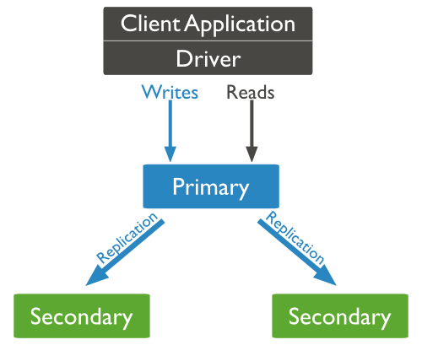
Here, the diagram of mongodb replication is shown in which client application always interact with primary node and primary node then replicate the data to the secondary nodes.
31

Slide 32
Automatic Scaling
MongoDB provides horizontal scalability as part of its core functionality.
Automatic sharding distributes data across a cluster of machines.
Sharding: Sharding is a method for storing data across multiple machines. MongoDB uses sharding to support deployments with very large data sets and high throughput operations.
32

Slide 33
To address these issues of scales, database systems have two basic approaches: vertical scaling and sharding.
Vertical scaling adds more CPU and storage resources to increase capacity. Scaling by adding capacity has limitations: high performance systems with large numbers of CPUs and large amount of RAM are disproportionately more expensive than smaller systems.
Sharding, or horizontal scaling, by contrast, divides the data set and distributes the data over multiple servers, or shards. Each shard is an independent database, and collectively, the shards make up a single logical database.
33

Slide 34
Sharding- Sharding is the process of storing data records across multiple machines and it is MongoDB's approach to meeting the demands of data growth.
As the size of the data increases, a single machine may not be sufficient to store the data nor provide an acceptable read and write throughput.
Sharding solves the problem with horizontal scaling.
With sharding, you add more machines to support data growth and the demands of read and write operations.
34

Slide 35
Sharding addresses the challenge of scaling to support high throughput and large data sets:
-Sharding reduces the number of operations each shard handles. Each shard processes fewer operations as the cluster grows. As a result, a cluster can increase capacity and throughput horizontally.
For example, to insert data, the application only needs to access the shard responsible for that record.
-Sharding reduces the amount of data that each server needs to store. Each shard stores less data as the cluster grows.
For example, if a database has a 1 terabyte data set, and there are 4 shards, then each shard might hold only 256GB of data. If there are 40 shards, then each shard might hold only 25GB of data.
35

Slide 36
Why Sharding?
In replication all writes go to master node
Memory can't be large enough when active dataset is big
Local Disk is not big enough
Vertical scaling is too expensive
36

Slide 37
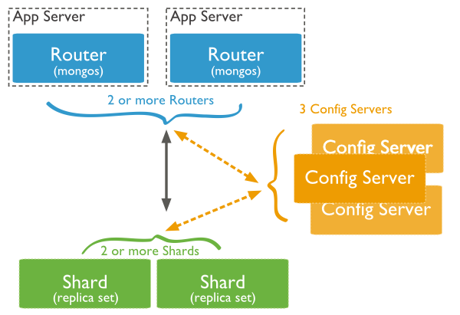
Diagram shows the sharding in MongoDB using sharded cluster.
37

Slide 38
In the given diagram there are three main components which are described below:
Shards: Shards are used to store data. They provide high availability and data consistency. In production environment each shard is a separate replica set.
Config Servers: Config servers store the cluster's metadata. This data contains a mapping of the cluster's data set to the shards. The query router uses this metadata to target operations to specific shards
Query Routers: Query Routers are basically mongos instances, interface with client applications and direct operations to the appropriate shard. The query router processes and targets operations to shards and then returns results to the clients. A sharded cluster can contain more than one query router to divide the client request load. A client sends requests to one query router. Generally a sharded cluster have many query routers.
38

Slide 39
MongoDB Advantages
Any relational database has a typical schema design that shows number of tables and the relationship between these tables. While in MongoDB there is no concept of relationship.
Advantages of MongoDB over RDBMS
Schema less : MongoDB is document database in which one collection holds different different documents. Number of fields, content and size of the document can be differ from one document to another.
Structure of a single object is clear
No complex joins
39

Slide 40
Deep query-ability. MongoDB supports dynamic queries on documents using a document-based query language that's nearly as powerful as SQL
Ease of scale-out: MongoDB is easy to scale.
40

Slide 41
Why should use MongoDB
Document Oriented Storage : Data is stored in the form of JSON style documents.
Index on any attribute
Replication & High Availability
Auto-Sharding
Professional Support By MongoDB
Where should use MongoDB?
Big Data
Content Management and Delivery
Mobile and Social Infrastructure
User Data Management
Data Hub
41

Slide 42
MongoDB Data Modeling
Data in MongoDB has a flexible schema. documents in the same collection do not need to have the same set of fields or structure, and common fields in a collection’s documents may hold different types of data.
Some considerations while designing schema in MongoDB
Design your schema according to user requirements.
Combine objects into one document if you will use them together. Otherwise separate them (but make sure there should not be need of joins).
42

Slide 43
Example
Suppose a client needs a database design for his blog website and see the differences between RDBMS and MongoDB schema design. Website has the following requirements.
Every post has the unique title, description and url.
Every post can have one or more tags.
Every post has the name of its publisher and total number of likes.
Every Post have comments given by users along with their name, message, date-time and likes.
On each post there can be zero or more comments.
43

Slide 44
In RDBMS schema design for above requirements will have minimum three tables.
A)Comments(Comment_id,post_id,by_usr,msg,date_time,likes)
B)Post(id,title,description,url,likes,post_by)
C)Tag_list(id,post_id,tag)
44

Slide 45
While in MongoDB schema design will have one collection post and has the following structure:
{ _id: POST_ID
title: TITLE_OF_POST,
description: POST_DESCRIPTION,
by: POST_BY,
url: URL_OF_POST,
tags: [TAG1, TAG2, TAG3],
likes: TOTAL_LIKES,
comments: [ {user:'COMMENT_BY',
message: TEXT,
dateCreated: DATE_TIME,
like: LIKES
},
{ user:'COMMENT_BY',
message: TEXT,
dateCreated: DATE_TIME,
like: LIKES
} ]
}
45

Slide 46
Sample document
Given example shows the document structure of a blog site which is simply a comma separated key value pair.
46

Slide 47
{
_id: ObjectId(7df78ad8902c)
title: 'MongoDB Overview',
description: 'MongoDB is no sql database',
by: 'tutorials point',
url: 'http://www.tutorialspoint.com',
tags: ['mongodb', 'database', 'NoSQL'],
likes: 100,
comments: [
{
user:'user1',
message: 'My first comment',
dateCreated: new Date(2011,1,20,2,15),
like: 0
},
47

Slide 48
{
user:'user2',
message: 'My second comments',
dateCreated: new Date(2011,1,25,7,45),
like: 5
}
]
}
_id is a 12 bytes hexadecimal number which assures the uniqueness of every document. You can provide _id while inserting the document. If you didn't provide then MongoDB provide a unique id for every document. These 12 bytes first 4 bytes for the current timestamp, next 3 bytes for machine id, next 2 bytes for process id of mongodb server and remaining 3 bytes are simple incremental value.
48

Slide 49
MongoDB Create Database
The use Command
MongoDB use DATABASE_NAME is used to create database. The command will create a new database, if it doesn't exist otherwise it will return the existing database.
SYNTAX:
use DATABASE_NAME
EXAMPLE:
If you want to create a database with name <mydb>, then use DATABASE statement would be as follows:
>use mydb
switched to db mydb.
49

Slide 50
To check your currently selected database use the command db
>db
mydb
If you want to check your databases list, then use the command show dbs.
>show dbs
local 0.78125GB
test 0.23012GB
50

Slide 51
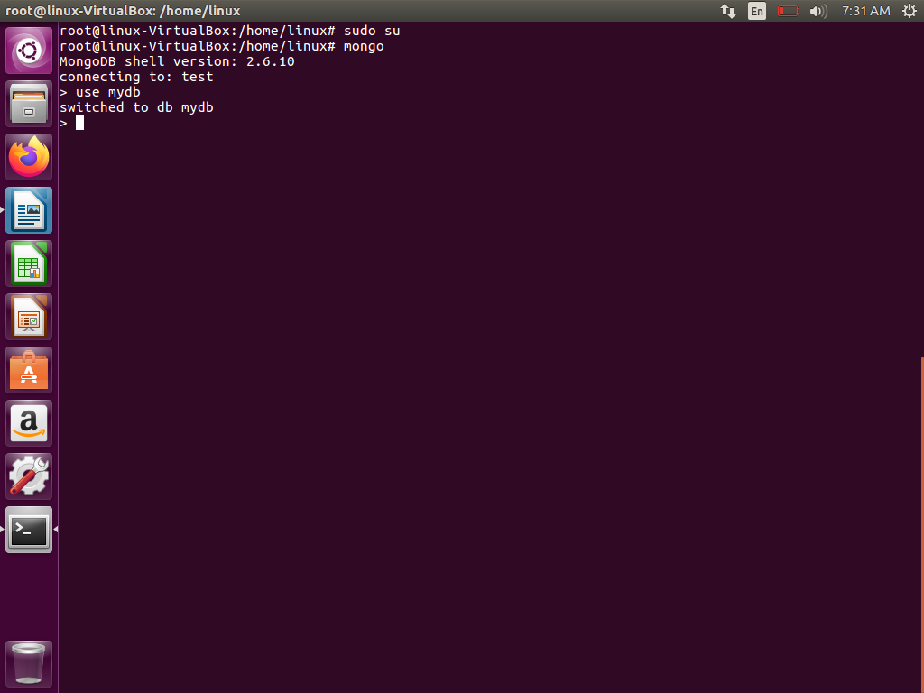
51

Slide 52
Your created database (mydb) is not present in list. To display database you need to insert atleast one document into it.
>db.tab1.insert({name:"tutorials point"})
>show dbs
local 0.78125GB
mydb 0.23012GB
test 0.23012GB
In mongodb default database is test. If you didn't create any database then collections will be stored in test database.
52

Slide 53
MongoDB Drop Database
The dropDatabase() Method
MongoDB db.dropDatabase() command is used to drop an existing database.
SYNTAX:
db.dropDatabase()
This will delete the selected database. If you have not selected any database, then it will delete default 'test' database
53

Slide 54
EXAMPLE:
First, check the list available databases by using the command show dbs
>show dbs
local 0.78125GB
mydb 0.23012GB
test 0.23012GB
If you want to delete new database <mydb>, then dropDatabase() command would be as follows:
>use mydb
switched to db mydb
>db.dropDatabase()
>{ "dropped" : "mydb", "ok" : 1 }
>
54

Slide 55
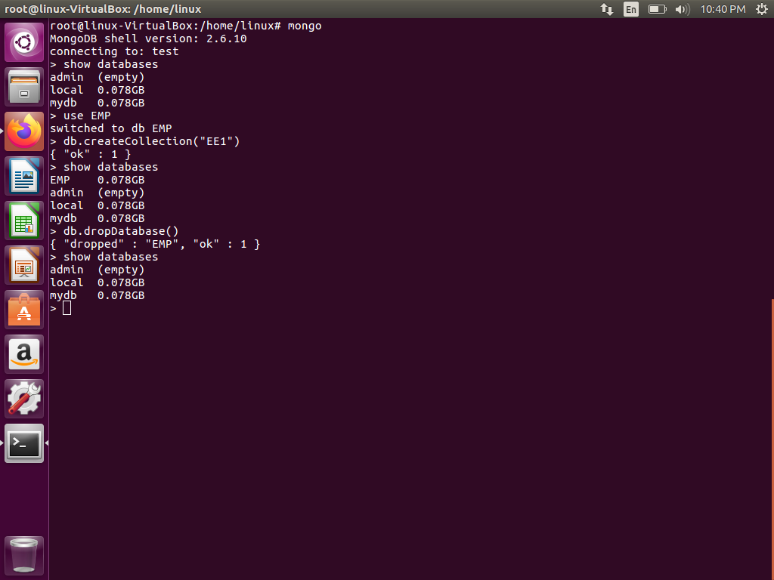
55

Slide 56
Now check list of databases
>show dbs
local 0.78125GB
test 0.23012GB
56

Slide 57
MongoDB Create Collection
The createCollection() Method
MongoDB db.createCollection(name, options) is used to create collection.
SYNTAX:
db.createCollection(name, options)
In the command, name is name of collection to be created. Options is a document and used to specify configuration of collection.
57

Slide 58
Parameter | Type | Description
Name | String | Name of the collection to be created
Options | Document | (Optional) Specify options about memory size and indexing
Options parameter is optional, so you need to specify only name of the collection. Following is the list of options you can use:
58

Slide 59
Field | Type | Description
Capped | Boolean | (Optional) If true, enables a capped collection. Capped collection is a collection fixed size collection that automatically overwrites its oldest entries when it reaches its maximum size. If you specify true, you need to specify size parameter also.
autoIndexID | Boolean | (Optional) If true, automatically create index on _id field.s Default value is false.
Size | number | (Optional) Specifies a maximum size in bytes for a capped collection. If capped is true, then you need to specify this field also.
Max | number | (Optional) Specifies the maximum number of documents allowed in the capped collection.
59

Slide 60
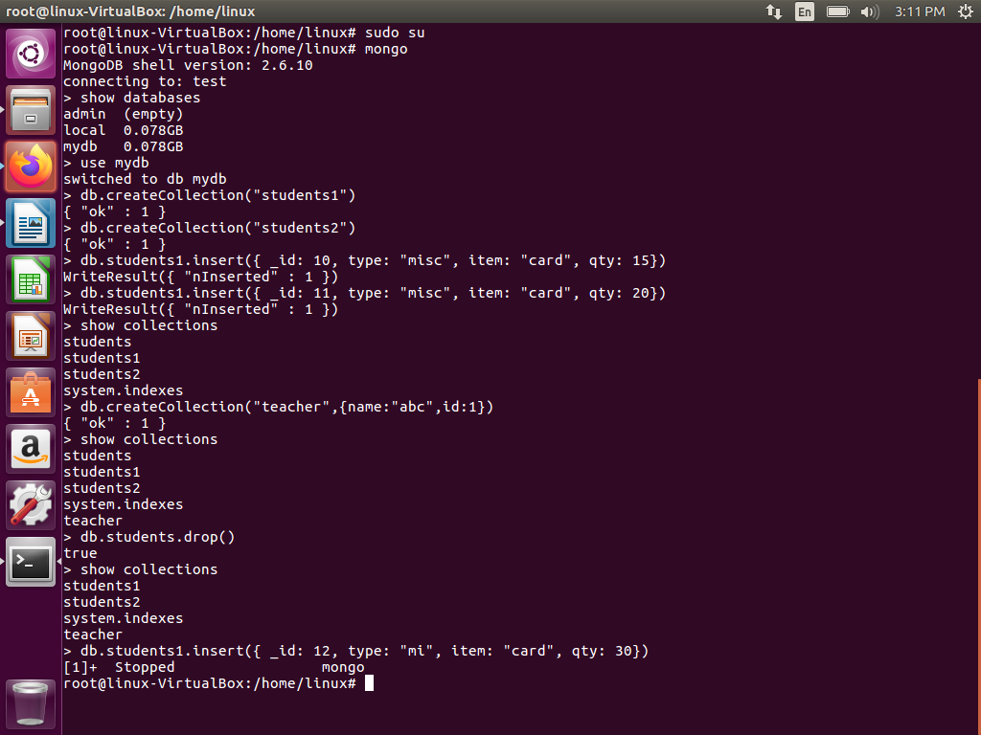
60

Slide 61
EXAMPLES:
Basic syntax of createCollection() method without options is as follows
>use test
switched to db test
>db.createCollection("mycollection")
{ "ok" : 1 }
You can check the created collection by using the command show collections
>show collections
mycollection
system.indexes
While inserting the document, MongoDB first checks size field of capped collection, then it checks max field.
61

Slide 62
Following example shows the syntax of createCollection() method with few important options:
>db.createCollection("mycol",
{ capped : true,
autoIndexID : true,
size : 6142800,
max : 10000 } )
{ "ok" : 1 }
>
62

Slide 63
In mongodb you don't need to create collection. MongoDB creates collection automatically, when you insert some document.
>db.demo.insert({"name" :"tutorials"})
>show collections
mycol
mycollection
system.indexes
demo
>
63

Slide 64
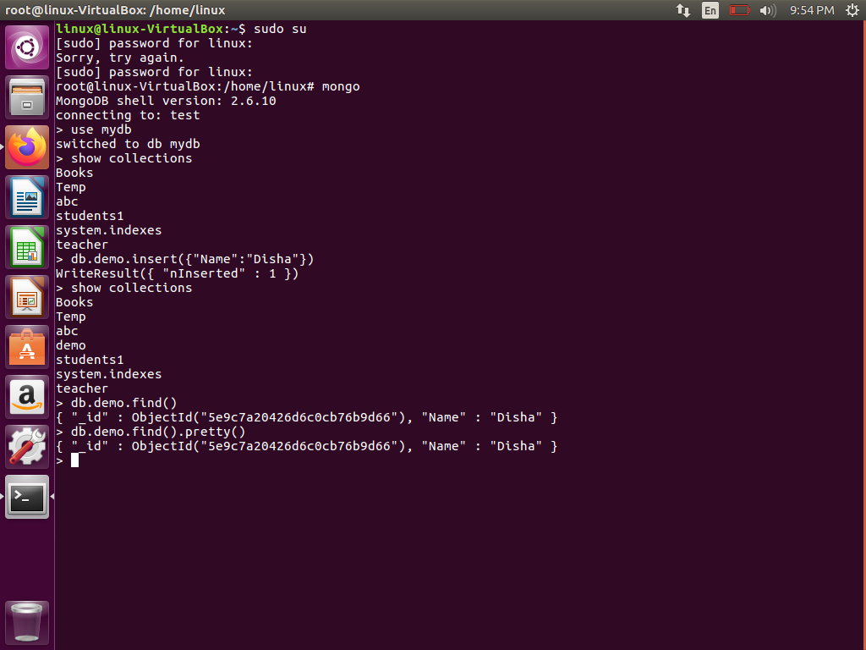

Slide 65
MongoDB Drop Collection
The drop() Method
MongoDB's db.collection.drop() is used to drop a collection from the database.
SYNTAX:
db.COLLECTION_NAME.drop()
EXAMPLE:
First, check the available collections into your database mydb
>use mydb
switched to db mydb
>show collections
mycol
mycollection
system.indexes
demo
>
65

Slide 66
Now drop the collection with the name mycollection
>db.mycollection.drop()
true
>
Again check the list of collections into database
>show collections
mycol
system.indexes
demo
>
drop() method will return true, if the selected collection is dropped successfully otherwise it will return false.
66

Slide 67
MongoDB - Insert Document
The insert() Method
To insert data into MongoDB collection, you need to use MongoDB's insert() or save()method.
In MongoDB, the db.collection.insert() method adds new documents into a collection.
In addition, both the db.collection.update() method and the db.collection.save() method can also add new documents through an operation called an upsert.
An upsert is an operation that performs either an update of an existing document or an insert of a new document if the document to modify does not exist.
67

Slide 68
SYNTAX
>db.COLLECTION_NAME.insert(document)
EXAMPLE
1)db.inventory.insert( { _id: 10, type: "misc", item: "card", qty: 15 } )
2)db.mycol.insert(
{ _id: ObjectId(7df78ad8902c),
title: 'MongoDB Overview',
description: 'MongoDB is no sql database',
by: 'tutorials point',
url: 'http://www.tutorialspoint.com',
tags: ['mongodb', 'database', 'NoSQL'],
likes: 100
}
)
68

Slide 69
Here mycol is our collection name. If the collection doesn't exist in the database, then MongoDB will create this collection and then insert document into it.
In the inserted document if we don't specify the _id parameter, then MongoDB assigns an unique ObjectId for this document.
_id is 12 bytes hexadecimal number unique for every document in a collection. 12 bytes are divided as follows:
_id: ObjectId(4 bytes timestamp, 3 bytes machine id,
2 bytes process id, 3 bytes incrementer)
To insert multiple documents in single query, you can pass an array of documents in insert() command.
69

Slide 70
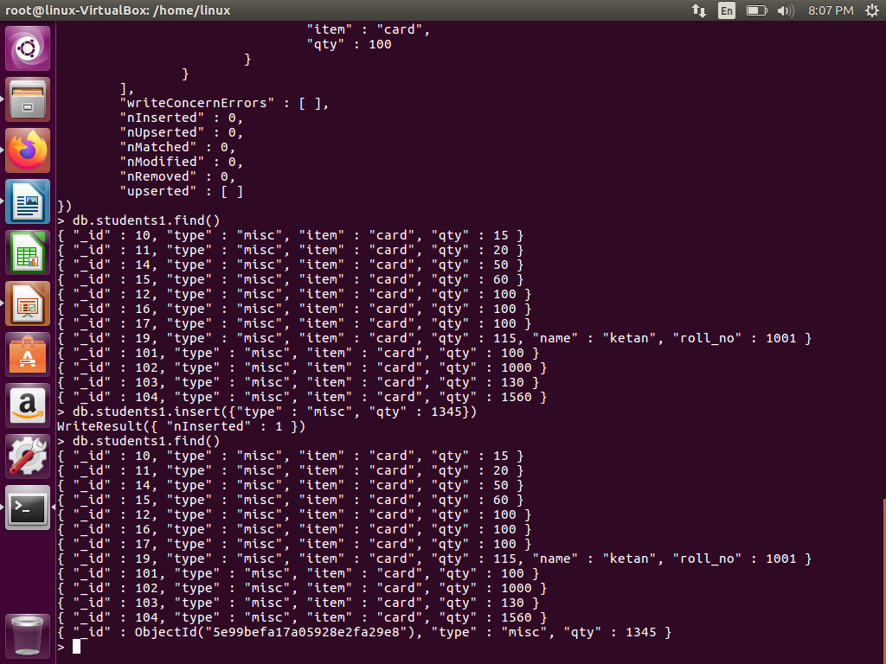

Slide 71
Insert Multiple Documents
The following example performs a bulk insert of three documents by passing an array of documents to the insert() method.
The documents in the array do not need to have the same fields.
For instance, the first document in the array has an _id field and a type field. Because the second and third documents do not contain an _id field,mongod will create the _id field for the second and third documents during the insert:
db.products.insert(
[
{ _id: 11, item: "pencil”,qty: 50, type: "no.2" },
{ item: "pen", qty: 20 },
{ item: "eraser", qty: 25 }
] )
71

Slide 72
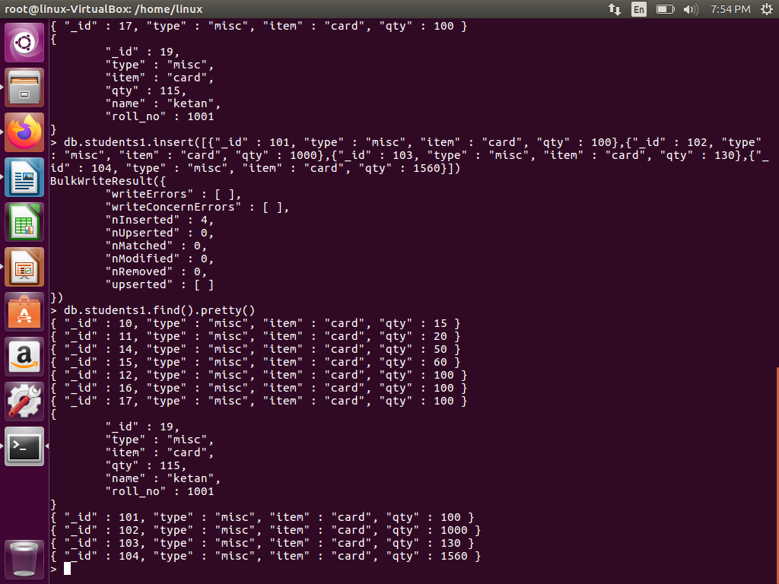

Slide 73
The operation inserted the following three documents:
{ "_id" : 11, "item" : "pencil", "qty" : 50, "type" : "no.2" }
{ "_id" : ObjectId("51e0373c6f35bd826f47e9a0"), "item" : "pen", "qty" : 20 }
{ "_id" : ObjectId("51e0373c6f35bd826f47e9a1"), "item" : "eraser", "qty" : 25 }
73

Slide 74
Insert a Document with update() Method
The following example creates a new document if no document in the inventory collection contains
{type: "book", item : "journal" }:
db.inventory.update(
{ type: "book", item : "journal" },
{ $set : { qty: 10 } },
{ upsert : true } )
MongoDB adds the _id field and assigns as its value a unique ObjectId. The new document includes the item and type fields from the <query> criteria and the qty field from the <update> parameter.
{ "_id" : ObjectId("51e8636953dbe31d5f34a38a"),
"item" :"journal", "qty" : 10, "type" : "book"
}
74

Slide 75
MongoDB Update Document
MongoDB's update() and save() methods are used to update document into a collection. The update() method update values in the existing document while the save() method replaces the existing document with the document passed in save() method.
MongoDB Update() method
The update() method updates values in the existing document.
SYNTAX:
>db.COLLECTION_NAME.update(SELECTIOIN_CRITERIA, UPDATED_DATA)
75

Slide 76
EXAMPLE
Consider the mycol collectioin has following data.
{ "_id" : ObjectId(5983548781331adf45ec5), "title":"MongoDB Overview"}
{ "_id" : ObjectId(5983548781331adf45ec6), "title":"NoSQL Overview"}
{ "_id" : ObjectId(5983548781331adf45ec7), "title":"Tutorials Point Overview"}
Following example will set the new title 'New MongoDB Tutorial' of the documents whose title is 'MongoDB Overview'
76

Slide 77
>db.mycol.update({'title':'MongoDB Overview'},{$set:{'title':'New MongoDB Tutorial'}})
>db.mycol.find()
{ "_id" : ObjectId(5983548781331adf45ec5), "title":"New MongoDB Tutorial"}
{ "_id" : ObjectId(5983548781331adf45ec6), "title":"NoSQL Overview"}
{ "_id" : ObjectId(5983548781331adf45ec7), "title":"Tutorials Point Overview"}
>
By default mongodb will update only single document, to update multiple you need to set a paramter 'multi' to true.
>db.mycol.update({'title':'MongoDB Overview'},
{$set:{'title':'New MongoDB Tutorial'}},
{multi:true}
)
77

Slide 78
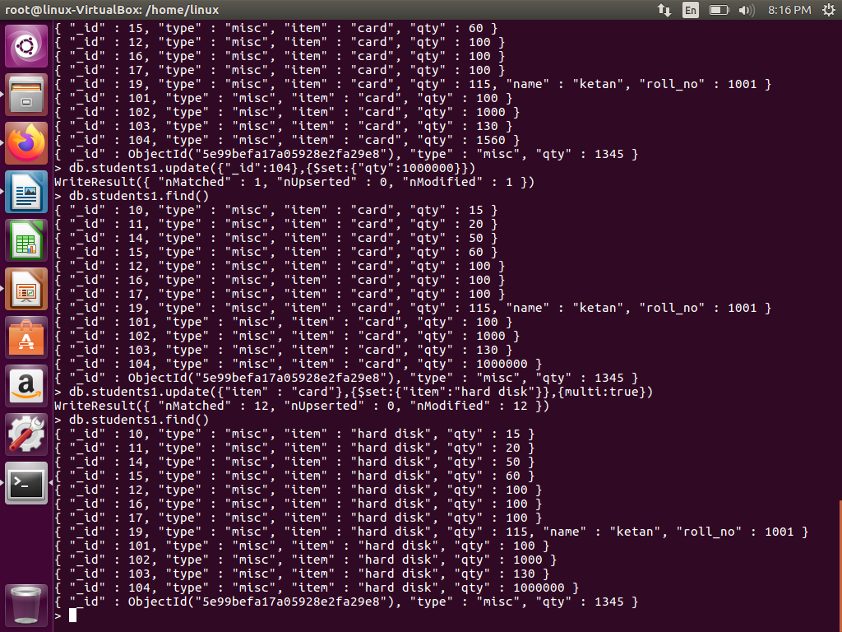

Slide 79
MongoDB Save() Method
The save() method replaces the existing document with the new document passed in save() method.
SYNTAX
>db.COLLECTION_NAME.save({_id:ObjectId(),NEW_DATA})
EXAMPLE
Following example will replace the document with the _id '5983548781331adf45ec7'
79

Slide 80
>db.mycol.save( { "_id" : ObjectId(5983548781331adf45ec7), "title":"Tutorials Point New Topic",
"by":"Tutorials Point"
}
)
>db.mycol.find()
{ "_id" : ObjectId(5983548781331adf45ec5),
"title":"Tutorials Point New Topic",
"by":"Tutorials Point“
}
{ "_id" : ObjectId(5983548781331adf45ec6),
"title":"NoSQL Overview“
}
{ "_id" : ObjectId(5983548781331adf45ec7),
"title":"Tutorials Point Overview“
}
>
80

Slide 81
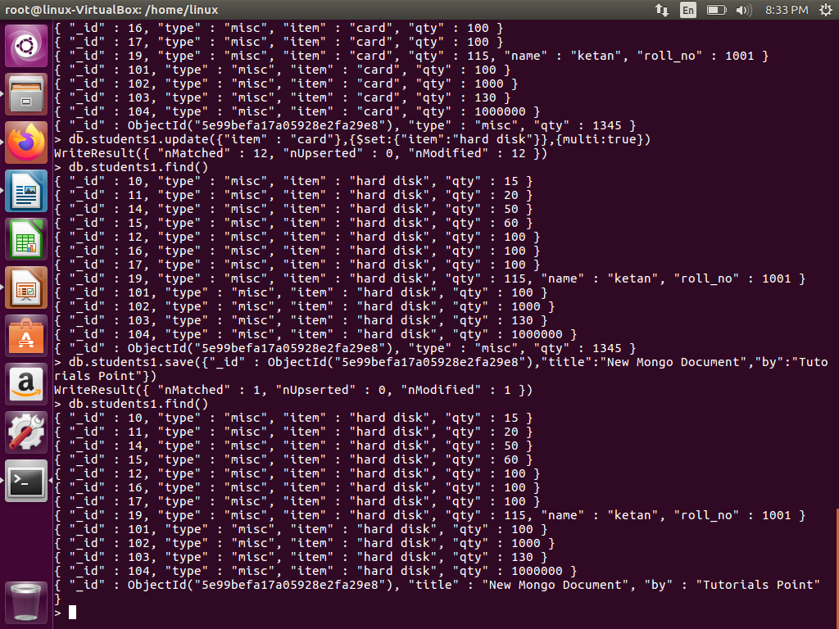

Slide 82
Insert a Document with save() Method
The following example creates a new document in the inventory collection:
db.inventory.save( { type: "book", item: "notebook", qty: 40 } )
MongoDB adds the _id field and assigns as its value a unique ObjectId.
{ "_id" : ObjectId("51e866e48737f72b32ae4fbc"),
"type" : "book",
"item" : "notebook",
"qty" : 40
}
82

Slide 83
Replace an Existing Document
The products collection contains the following document:
{ "_id" : 100, "item" : "water", "qty" : 30 }
The save() method performs an update with upsert since the document contains an _id field:
db.products.save( { _id : 100, item : "juice" } )
Because the _id field holds a value that exists in the collection, the operation performs an update to replace the document and results in the following document:
{ "_id" : 100, "item" : "juice" }
83

Slide 84
MongoDB - Query Document
The find() Method
To query data from MongoDB collection, you need to use MongoDB's find() method.
SYNTAX
>db.COLLECTION_NAME.find()
find() method will display all the documents in a non structured way.
84

Slide 85
The pretty() Method
To display the results in a formatted way, you can use pretty() method.
SYNTAX:
>db.mycol.find().pretty()
85

Slide 86
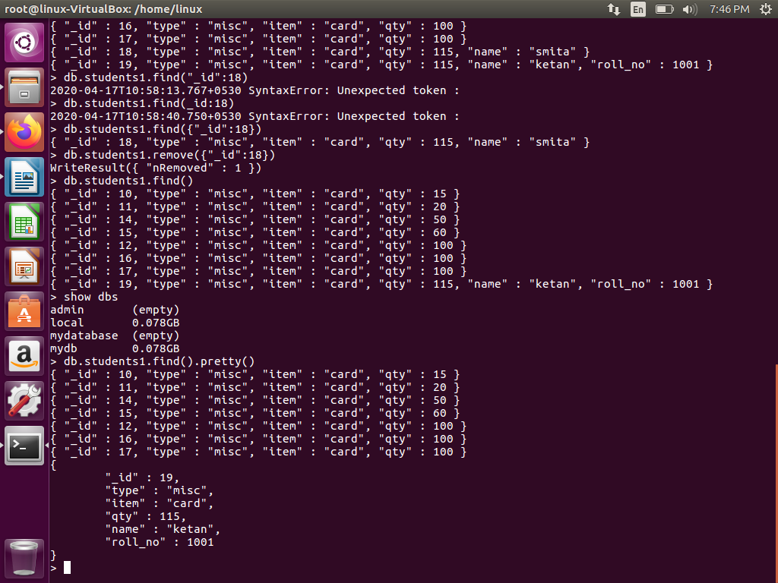

Slide 87
Example
>db.mycol.find().pretty()
{ "_id": ObjectId(7df78ad8902c),
"title": "MongoDB Overview",
"description": "MongoDB is no sql database",
"by": "tutorials point",
"url": "http://www.tutorialspoint.com",
"tags": ["mongodb", "database", "NoSQL"],
"likes": "100”
}
>
87

Slide 88
Specify Equality Condition
To specify equality condition, use the query document { <field>: <value> } to select all documents that contain the <field> with the specified <value>.
The following example retrieves from the inventory collection all documents where the type field has the value snacks:
db.inventory.find( { type: "snacks" } )
88

Slide 89
Specify Conditions Using Query Operators
A query document can use the query operators to specify conditions in a MongoDB query.
The following example selects all documents in the inventory collection where the value of the type field is either 'food' or 'snacks':
db.inventory.find( { type: { $in: [ 'food', 'snacks' ] } } )
Although you can express this query using the $or operator, use the $in operator rather than the $or operator when performing equality checks on the same field.
89

Slide 90
The $or operator performs a logical OR operation on an array of two or more <expressions> and selects the documents that satisfy at least one of the <expressions>.
The $or has the following syntax:
{ $or: [ { <expression1> }, { <expression2> }, ... , { <expressionN> } ] }
Example:
db.inventory.find( { $or: [ { quantity: { $lt: 20 }} , { price: 10 } ] } )
This query will select all documents in the inventory collection where either the quantity field value is less than 20 or the price field value equals 10.
90

Slide 91
RDBMS Where Clause Equivalents in MongoDB
To query the document on the basis of some condition, you can use following operations
Operation | Syntax | Example | RDBMS Equivalent
Equality | {<key>:<value>} | db.mycol.find({"by":"tutorials ”}).pretty() | where by = 'tutorials point'
Less Than | {<key>:{$lt:<value>}} | db.mycol.find({"likes":{$lt:50}}).pretty() | where likes < 50
Less Than Equals | {<key>:{$lte:<value>}} | db.mycol.find({"likes":{$lte:50}}).pretty() | where likes <= 50
91

Slide 92
Greater Than | {<key>:{$gt:<value>}} | db.mycol.find({"likes":{$gt:50}}).pretty() | where likes > 50
Greater Than Equals | {<key>:{$gte:<value>}} | db.mycol.find({"likes":{$gte:50}}).pretty() | where likes >= 50
Not Equals | {<key>:{$ne:<value>}} | db.mycol.find({"likes":{$ne:50}}).pretty() | where likes != 50
Greater Than | {<key>:{$gt:<value>}} | db.mycol.find({"likes":{$gt:50}}).pretty() | where likes > 50
92

Slide 93
Specify AND Conditions
A compound query can specify conditions for more than one field in the collection’s documents.
Implicitly, a logical AND conjunction connects the clauses of a compound query so that the query selects the documents in the collection that match all the conditions.
In the following example, the query document specifies an equality match on the field food and a less than ($lt) comparison match on the field price:
db.inventory.find( { type: 'food', price: { $lt: 9.95 } } )
This query selects all documents where the type field has the value 'food' and the value of the price field is less than 9.95.
93

Slide 94
Specify OR Conditions
Using the $or operator, you can specify a compound query that joins each clause with a logical OR conjunction so that the query selects the documents in the collection that match at least one condition.
In the following example, the query document selects all documents in the collection where the field qty has a value greater than ($gt) 100 or the value of the price field is less than ($lt) 9.95:
db.inventory.find( { $or: [ { qty: { $gt: 100 } },
{ price: { $lt: 9.95 } }
] } )
94

Slide 95
Specify AND as well as OR Conditions
With additional clauses, you can specify precise conditions for matching documents.
In the following example, the compound query document selects all documents in the collection where the value of the type field is 'food' and either the qty has a value greater than ($gt) 100 or the value of the price field is less than ($lt) 9.95:
db.inventory.find( { type: 'food',
$or: [ { qty: { $gt: 100 } },
{ price: { $lt: 9.95 } }
]
}
)
95

Slide 96
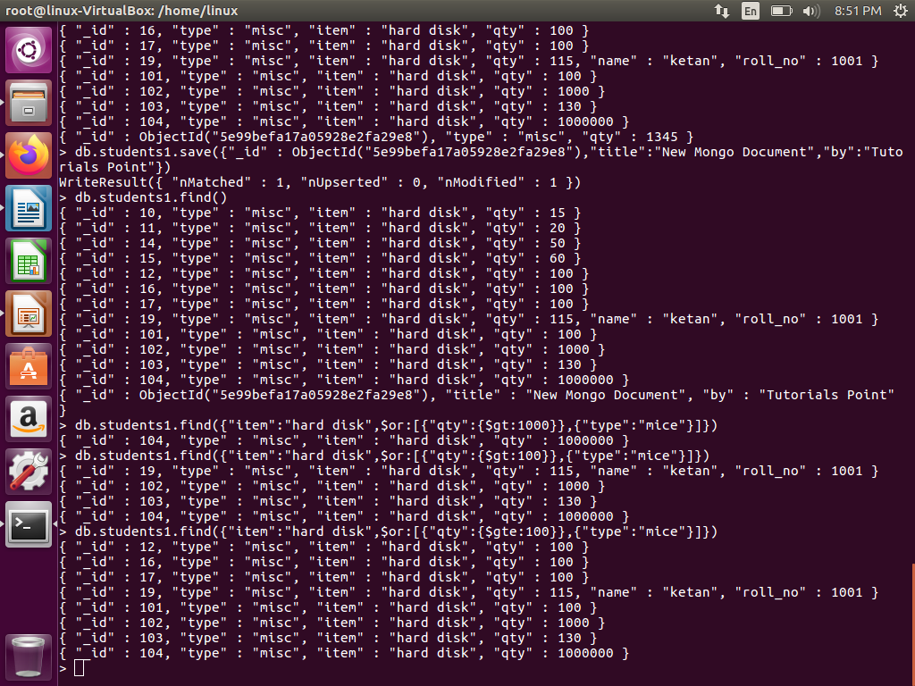

Slide 97
MongoDB Delete Document
The remove() Method
MongoDB's remove() method is used to remove document from the collection. remove() method accepts two parameters. One is deletion criteria and second is justOne flag
deletion criteria : (Optional) deletion criteria according to documents will be removed.
justOne : (Optional) if set to true or 1, then remove only one document.
SYNTAX:
>db.COLLECTION_NAME.remove(DELLETION_CRITTERIA)
97

Slide 98
EXAMPLE
Consider the mycol collection has following data.
{ "_id" : ObjectId(5983548781331adf45ec5), "title":"MongoDB Overview"}
{ "_id" : ObjectId(5983548781331adf45ec6), "title":"NoSQL Overview"}
{ "_id" : ObjectId(5983548781331adf45ec7), "title":"Tutorials Point Overview"}
98

Slide 99
Following example will remove all the documents whose title is 'MongoDB Overview‘
>db.mycol.remove({'title':'MongoDB Overview'})
>db.mycol.find()
{ "_id" : ObjectId(5983548781331adf45ec6), "title":"NoSQL Overview"}
{ "_id" : ObjectId(5983548781331adf45ec7), "title":"Tutorials Point Overview"}
99

Slide 100
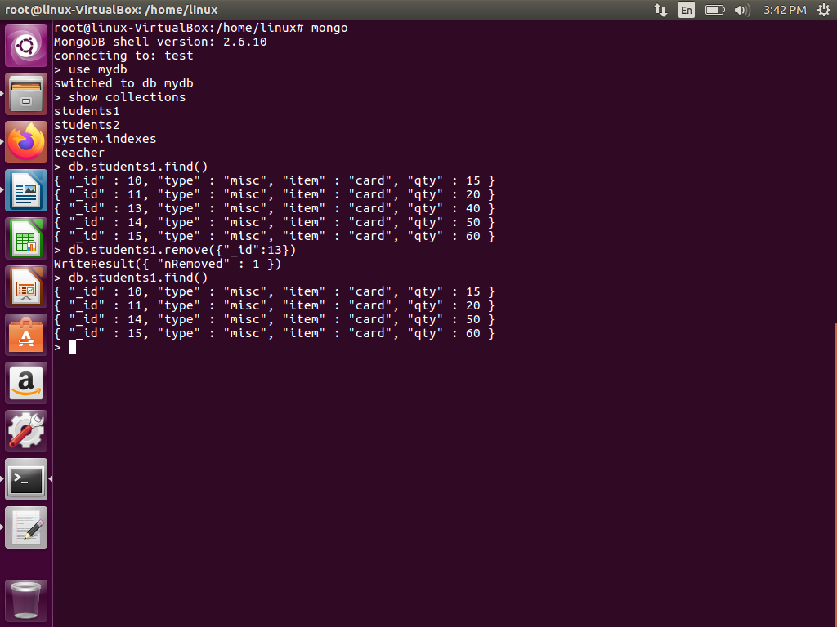

Slide 101
Remove All documents
If you don't specify deletion criteria, then mongodb will delete whole documents from the collection.
This is equivalent of SQL's truncate command.
To remove all documents from a collection, pass an empty query document {} to the remove() method.
The remove() method does not remove the indexes.
The following example removes all documents from the inventory collection:
db.inventory.remove({})
To remove all documents from a collection, it may be more efficient to use the drop() method to drop the entire collection, including the indexes, and then recreate the collection and rebuild the indexes.
101

Slide 102
Remove Documents that Match a Condition
To remove the documents that match a deletion criteria, call the remove() method with the <query>parameter.
The following example removes all documents from the inventory collection where the type field equals food:
db.inventory.remove( { type : "food" } )
For large deletion operations, it may be more efficient to copy the documents that you want to keep to a new collection and then use drop() on the original collection.
102

Slide 103
Remove a Single Document that Matches a Condition
To remove a single document, call the remove() method with the justOne parameter set to true or 1.
The following example removes one document from the inventory collection where the type field equals food:
db.inventory.remove( { type : "food" }, 1 )
103

Slide 104
MongoDB Projection
In mongodb, projection meaning is selecting only necessary data rather than selecting whole of the data of a document. If a document has 5 fields and you need to show only 3, then select only 3 fields from them.
The find() Method
In MongoDB when you execute find() method, then it displays all fields of a document. To limit this you need to set list of fields with value 1 or 0. 1 is used to show the field while 0 is used to hide the field.
SYNTAX:
>db.COLLECTION_NAME.find({},{KEY:1})
104

Slide 105
EXAMPLE
Consider the collection myycol has the following data
{ "_id" : ObjectId(5983548781331adf45ec5), "title":"MongoDB Overview"}
{ "_id" : ObjectId(5983548781331adf45ec6), "title":"NoSQL Overview"}
{ "_id" : ObjectId(5983548781331adf45ec7), "title":"Tutorials Point Overview"}
Following example will display the title of the document while quering the document.
>db.mycol.find({},{"title":1,_id:0})
{"title":"MongoDB Overview"}
{"title":"NoSQL Overview"}
{"title":"Tutorials Point Overview"}
>
_id field is always displayed while executing find() method, if you don't want this field, then you need to set it as 0
105

Slide 106
MongoDB Limit Records
The Limit() Method
To limit the records in MongoDB, you need to use limit() method. limit() method accepts one number type argument, which is number of documents that you want to displayed.
SYNTAX:
>db.COLLECTION_NAME.find().limit(NUMBER)
106

Slide 107
EXAMPLE
Consider the collection mycol has the following data
{ "_id" :1, "title":"MongoDB Overview"}
{ "_id" : 2, "title":"NoSQL Overview"}
{ "_id" : 3, "title":"Tutorials Point Overview"}
Following example will display only 2 documents while querying the document.
db.mycol.find({},{"title":1,_id:0}).limit(2)
{"title":"MongoDB Overview"}
{"title":"NoSQL Overview"}
If you don't specify number argument in limit() method then it will display all documents from the collection.
107

Slide 108
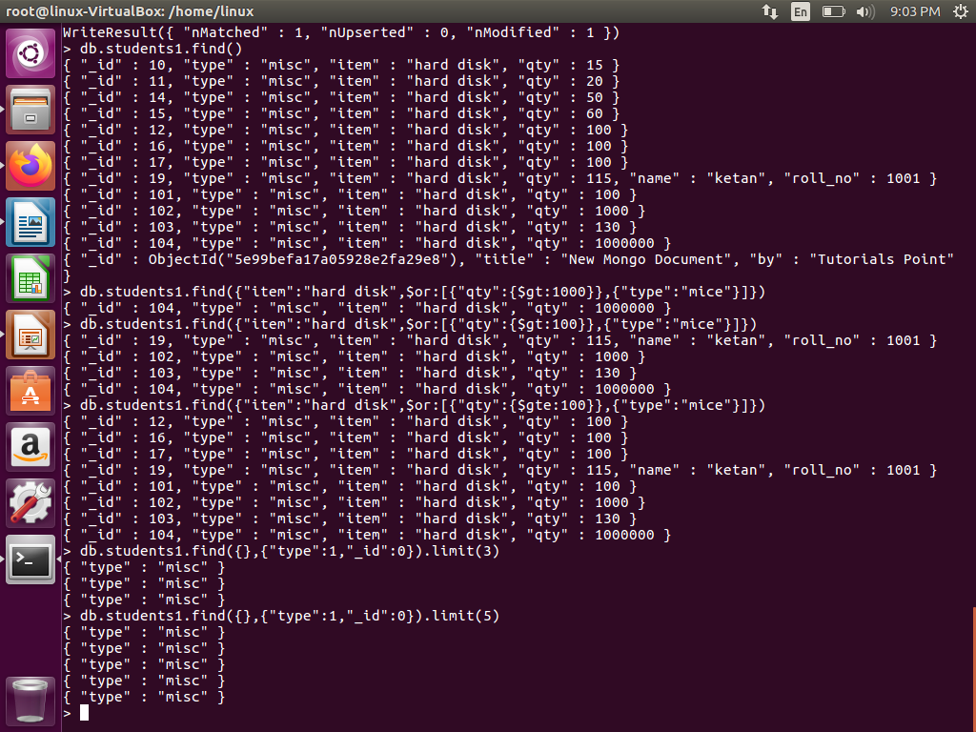

Slide 109
MongoDB Skip() Method
Apart from limit() method there is one more method skip() which also accepts number type argument and used to skip number of documents.
SYNTAX:
>db.COLLECTION_NAME.find().limit(NUMBER).skip(NUMBER)
EXAMPLE:
Following example will only display only second document.
>db.mycol.find({},{"title":1,_id:0}).limit(1).skip(1)
{"title":"NoSQL Overview"}
>
Default value in skip() method is 0
109

Slide 110
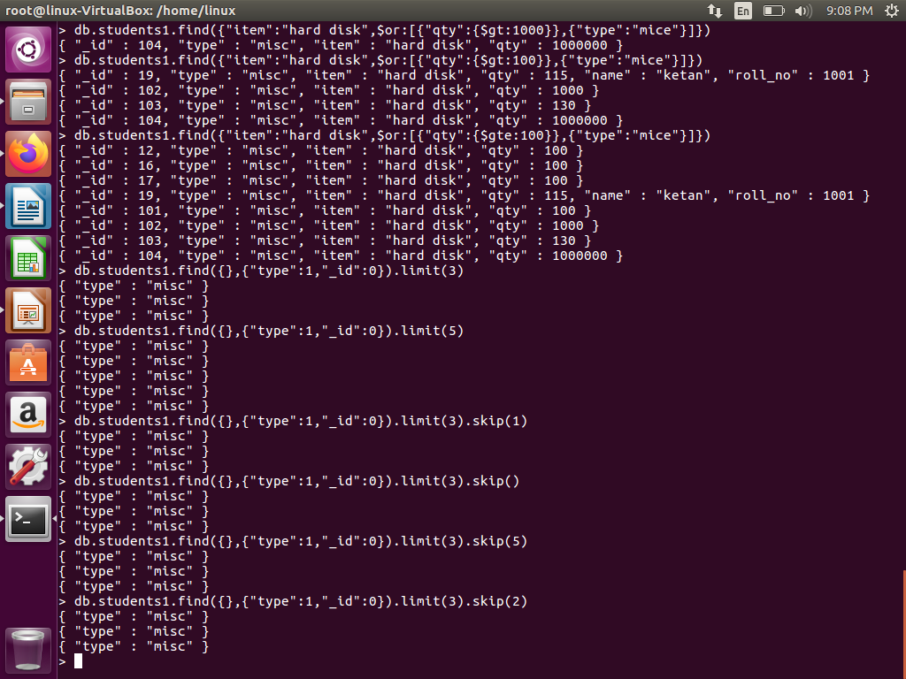

Slide 111
MongoDB Sort Documents
The sort() Method
To sort documents in MongoDB, use sort() method. sort() method accepts a document containing list of fields along with their sorting order. To specify sorting order 1 and -1 are used. 1 is used for ascending order while -1 is used for descending order.
SYNTAX:
>db.COLLECTION_NAME.find().sort({KEY:1})
EXAMPLE
Consider the collection mycol has the following data
{ "_id" : ObjectId(5983548781331adf45ec5), "title":"MongoDB Overview"}
{ "_id" : ObjectId(5983548781331adf45ec6), "title":"NoSQL Overview"}
{ "_id" : ObjectId(5983548781331adf45ec7), "title":"Tutorials Point Overview"}
111

Slide 112
Following example will display the documents sorted by title in descending order.
>db.mycol.find({},{"title":1,_id:0}).sort({"title":-1})
{"title":"Tutorials Point Overview"}
{"title":"NoSQL Overview"}
{"title":"MongoDB Overview"}
If you don't specify the sorting preference, then sort() method will display documents in ascending order.
112

Slide 113
MongoDB Aggregation
Aggregations operations process data records and return computed results.
Aggregation operations group values from multiple documents together, and can perform a variety of operations on the grouped data to return a single result.
MongoDB provides a rich set of aggregation operations that examine and perform calculations on the data sets.
Like queries, aggregation operations in MongoDB use collections of documents as an input and return results in the form of one or more documents.
113

Slide 114
In sql count(*) and with group by is an equivalent of mongodb aggregation.
The aggregate() Method
For the aggregation in mongodb use aggregate() method.
SYNTAX:
db.COLLECTION_NAME.aggregate(AGGREGATE_OPERATION)
114

Slide 115
EXAMPLE:
In the collection you have the following data:
{ _id: ObjectId(7df78ad8902c)
title: 'MongoDB Overview',
description: 'MongoDB is no sql database',
by_user: 'tutorials point',
url: 'http://www.tutorialspoint.com',
tags: ['mongodb', 'database', 'NoSQL'],
likes: 100
},
115

Slide 116
{ _id: ObjectId(7df78ad8902d)
title: 'NoSQL Overview',
description: 'No sql database is very fast',
by_user: 'tutorials point',
url: 'http://www.tutorialspoint.com',
tags: ['mongodb', 'database', 'NoSQL'], likes: 10 },
{ _id: ObjectId(7df78ad8902e)
title: 'Neo4j Overview',
description: 'Neo4j is no sql database',
by_user: 'Neo4j',
url: 'http://www.neo4j.com',
tags: ['neo4j', 'database', 'NoSQL'],
likes: 750
},
116

Slide 117
Now from the above collection if you want to display a list that how many tutorials are written by each user then use following aggregate() method :
db.mycol.aggregate(
[
{
$group :
{_id : "$by_user", num_tutorial : {$sum : 1}}
}
] )
117

Slide 118
Output:
{
"result" : [
{
"_id" : "tutorials point",
"num_tutorial" : 2
},
{
"_id" : “Neo4j",
"num_tutorial" : 1
}
],
"ok" : 1 }
118

Slide 119
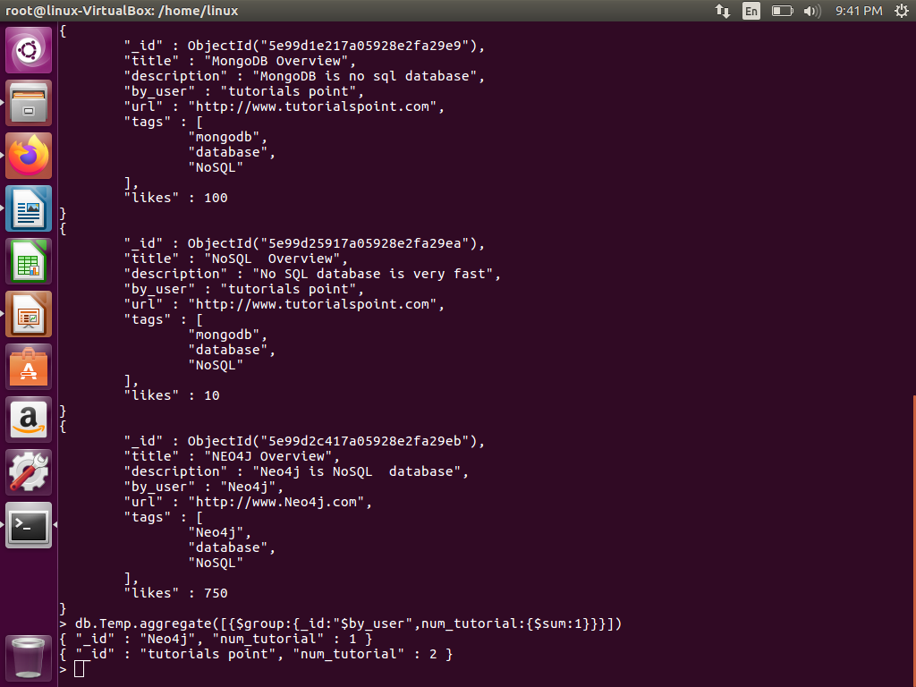

Slide 120
Sql equivalent query for the above use case will be
select by_user, count(*)
from mycol
group by by_user
In the above example we have grouped documents by field by_user and on each occurence of by_user previous value of sum is incremented.
A list available for aggregation expressions.
120

Slide 121
Expression | Description | Example
$sum | Sums up the defined value from all documents in the collection. | db.mycol.aggregate([{$group : {_id : "$by_user", num_tutorial : {$sum : "$likes"}}}])
$avg | Calculates the average of all given values from all documents in the collection. | db.mycol.aggregate([{$group : {_id : "$by_user", num_tutorial : {$avg : "$likes"}}}])
$min | Gets the minimum of the corresponding values from all documents in the collection. | db.mycol.aggregate([{$group : {_id : "$by_user", num_tutorial : {$min : "$likes"}}}])
$max | Gets the maximum of the corresponding values from all documents in the collection. | db.mycol.aggregate([{$group : {_id : "$by_user", num_tutorial : {$max : "$likes"}}}])
121

Slide 122
$push | Inserts the value to an array in the resulting document. | db.mycol.aggregate([{$group : {_id : "$by_user", url : {$push: "$url"}}}])
$addToSet | Inserts the value to an array in the resulting document but does not create duplicates. | db.mycol.aggregate([{$group : {_id : "$by_user", url : {$addToSet : "$url"}}}])
$first | Gets the first document from the source documents according to the grouping. | db.mycol.aggregate([{$group : {_id : "$by_user", first_url : {$first : "$url"}}}])
$last | Gets the last document from the source documents according to the grouping. | db.mycol.aggregate([{$group : {_id : "$by_user", last_url : {$last : "$url"}}}])
122

Slide 123
Example
A collection books contains the following documents:
{ "_id" : 8751, "title" : "The Banquet", "author" : "Dante", "copies" : 2 }
{ "_id" : 8752, "title" : "Divine Comedy", "author" : "Dante", "copies" : 1 }
{ "_id" : 8645, "title" : "Eclogues", "author" : "Dante", "copies" : 2 }
{ "_id" : 7000, "title" : "The Odyssey", "author" : "Homer", "copies" : 10 }
{ "_id" : 7020, "title" : "Iliad", "author" : "Homer", "copies" : 10 }
123

Slide 124
Group title by author
The following aggregation operation pivots the data in the books collection to have titles grouped by authors.
db.books.aggregate (
[
{ $group :
{ _id : "$author", books: { $push: "$title" } }
}
]
)
The operation returns the following documents:
{ "_id" : "Homer", "books" : [ "The Odyssey", "Iliad" ] }
{ "_id" : "Dante", "books" : [ "The Banquet", "Divine Comedy", "Eclogues" ] }
124

Slide 125
Group Documents by author
The following aggregation operation uses the $$ROOT system variable to group the documents by authors. The resulting documents must not exceed the BSON Document Size limit.
db.books.aggregate(
[
{
$group :
{ _id : "$author", books: { $push: "$$ROOT" } }
}
]
)
125

Slide 126
The operation returns the following documents:
{ "_id" : "Homer", "books" :
[
{ "_id" : 7000, "title" : "The Odyssey", "author" : "Homer", "copies" : 10 },
{ "_id" : 7020, "title" : "Iliad", "author" : "Homer", "copies" : 10 }
]
}
{ "_id" : "Dante", "books" :
[
{ "_id" : 8751, "title" : "The Banquet", "author" : "Dante", "copies" : 2 },
{ "_id" : 8752, "title" : "Divine Comedy", "author" : "Dante", "copies" : 1 },
{ "_id" : 8645, "title" : "Eclogues", "author" : "Dante", "copies" : 2 }
]
}
126

Slide 127
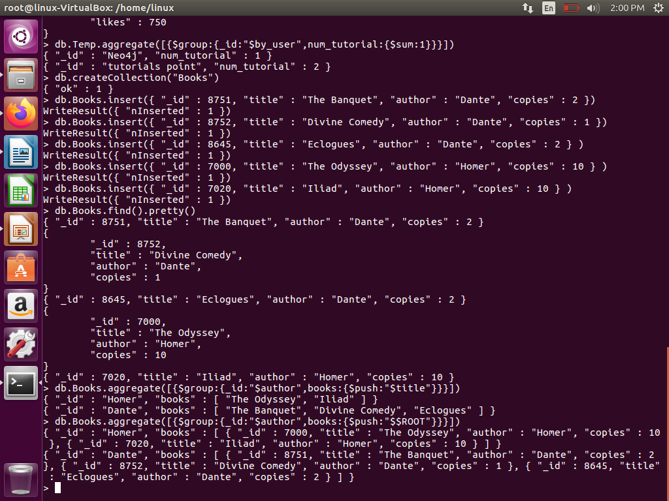

Slide 128
Aggregation Pipeline
The aggregation pipeline is a framework for data aggregation modeled on the concept of data processing pipelines.
Documents enter a multi-stage pipeline that transforms the documents into an aggregated results.
The aggregation pipeline provides an alternative to map-reduce and may be the preferred solution for many aggregation tasks.
128

Slide 129
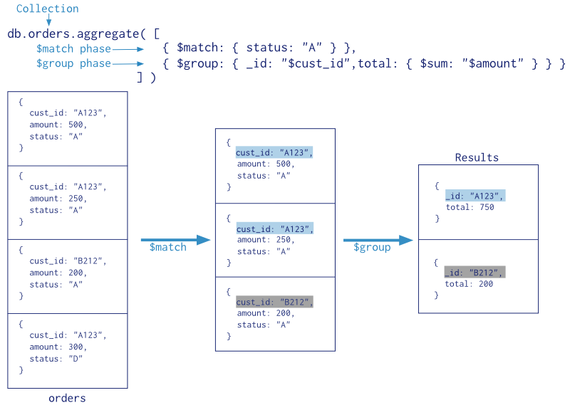
129

Slide 130
Map-Reduce
Map-reduce is a data processing paradigm for condensing large volumes of data into useful aggregated results.
For map-reduce operations, MongoDB provides the mapReduce database command.
db.collection.mapReduce(
<map>,
<reduce>,
{ out: <collection>,
query: <document>,
sort: <document>,
limit: <number>,
finalize: <function>,
scope: <document>,
jsMode: <boolean>,
verbose: <boolean> }
)
130

Slide 131
MapReduce Command:
Syntax:
db.collection.mapReduce(
function()
{emit(key,value);}, //map function
function(key,values){ return reduceFunction}, //reduce function
{ out: collection,
query: document,
sort: document,
limit: number
}
)
131

Slide 132
The map-reduce function first queries the collection, then maps the result documents to emit key-value pairs which is then reduced based on the keys that have multiple values.
In the above syntax:
map is a javascript function that maps a value with a key and emits a key-value pair
reduce is a javscript function that reduces or groups all the documents having the same key
out specifies the location of the map-reduce query result
query specifies the optional selection criteria for selecting documents
sort specifies the optional sort criteria
132

Slide 133
limit specifies the optional maximum number of documents to be returned
finalize follows the reduce method and modifies the output.
Scope specifies global variables that are accessible in the map ,reduce and finalize functions.
jsMode Specifies whether to convert intermediate data into BSON format between the execution of the map and reduce functions. Defaults to false.
verbose specifies whether to include the timing information in the result information. The verbose defaults to true to include the timing information.
133

Slide 134
Requirements for the map Function
function() { ... emit(key, value); }
In the map function, reference the current document as this within the function.
The emit(key,value) function associates the key with a value.
The map function can call emit(key,value) any number of times, including 0, per each input document.
Consider the map function may call emit(key,value) either 0 or 1 times depending on the value of the input document’s status field:
134

Slide 135
function()
{
if (this.status == 'A')
emit(this.cust_id, 1);
}
135

Slide 136
Requirements for the reduce Function
The reduce function has the following prototype:
function(key, values)
{ ... return result; }
MongoDB will not call the reduce function for a key that has only a single value.
MongoDB can invoke the reduce function more than once for the same key.
The reduce function can access the variables defined in the scope parameter.
136

Slide 137
Requirements for the finalize Function
The finalize function has the following prototype:
function(key, reducedValue)
{ ... return modifiedObject; }
The finalize function receives as its arguments a key value and the reducedValue from the reduce function.
The finalize function can access the variables defined in the scope parameter.
137

Slide 138
Using MapReduce:
Consider the following document structure storing user posts.
The document stores user_name of the user and the status of post.
{
"post_text": "tutorialspoint is an awesome website”, "user_name": "mark",
"status":"active"
}
138

Slide 139
Now, we will use a mapReduce function on our posts collection to select all the active posts, group them on the basis of user_name and then count the number of posts by each user using the following code:
139

Slide 140
db.posts.mapReduce(
function()
{ emit(this.user_name,1); },
function(key, values) {return Array.sum(values)},
{
query:{status:"active"},
out:"post_total"
}
)
140

Slide 141
Output:
{
"result" : "post_total",
"timeMillis" : 9,
"counts" :
{
"input" : 4,
"emit" : 4,
"reduce" : 2,
"output" : 2
},
"ok" : 1, }
The result shows that a total of 4 documents matched the query (status:"active"), the map function emitted 4 documents with key-value pairs and finally the reduce function grouped mapped documents having the same keys into 2.
141

Slide 142
To see the result of this mapReduce query use the find operator:
db.posts.mapReduce( function() { emit(this.user_id,1); },
function(key, values) {return Array.sum(values)},
{
query:{status:"active"},
out:"post_total"
}
).find()
142

Slide 143
Consider the following map-reduce operation:
143

Slide 144
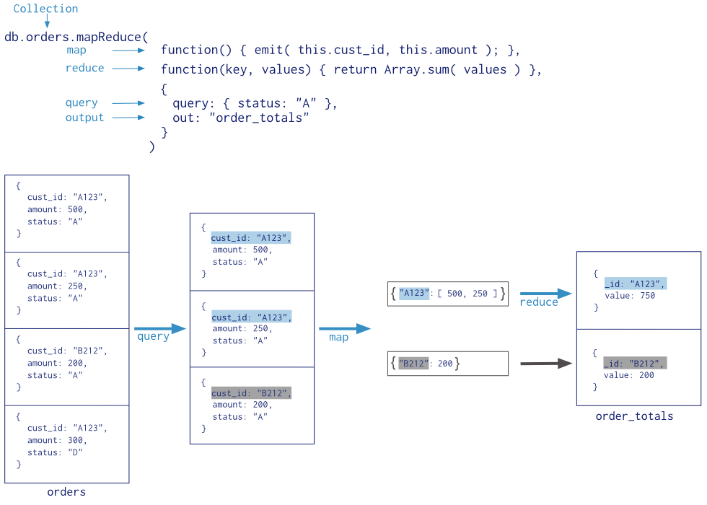
144

Slide 145
In this map-reduce operation, MongoDB applies the map phase to each input document (i.e. the documents in the collection that match the query condition).
The map function emits key-value pairs. For those keys that have multiple values, MongoDB applies the reduce phase, which collects and condenses the aggregated data. MongoDB then stores the results in a collection.
145

Slide 146
All map-reduce functions in MongoDB are JavaScript and run within the mongod process.
Map-reduce operations take the documents of a single collection as the input and can perform any arbitrary sorting and limiting before beginning the map stage.
mapReduce can return the results of a map-reduce operation as a document, or may write the results to collections.
The input and the output collections may be sharded.
146

Slide 147
Map-Reduce Examples
Consider the following map-reduce operations on a collection orders that contains documents of the following prototype:
{ _id: ObjectId("50a8240b927d5d8b5891743c"),
cust_id: "abc123",
ord_date: new Date("Oct 04, 2012"),
status: 'A', price: 25,
items: [ { sku: "mmm", qty: 5, price: 2.5 },
{ sku: "nnn", qty: 5, price: 2.5 }
]
}
147

Slide 148
Return the Total Price Per Customer
Perform the map-reduce operation on the orders collection to group by the cust_id, and calculate the sum of the price for each cust_id:
1)Define the map function to process each input document:
In the function, this refers to the document that the map-reduce operation is processing.
The function maps the price to the cust_id for each document and emits the cust_id and price pair.
var mapFunction1 = function()
{
emit(this.cust_id, this.price);
};
148

Slide 149
2)Define the corresponding reduce function with two arguments keyCustId and valuesPrices:
The valuesPrices is an array whose elements are the price values emitted by the map function and grouped by keyCustId.
The function reduces the valuesPrice array to the sum of its elements.
var reduceFunction1 = function(keyCustId, valuesPrices)
{
return Array.sum(valuesPrices);
};
149

Slide 150
3)Perform the map-reduce on all documents in the orders collection using the mapFunction1 map function and the reduceFunction1 reduce function.
db.orders.mapReduce( mapFunction1,
reduceFunction1,
{
out: "map_reduce_example"
} )
This operation outputs the results to a collection named map_reduce_example.
If the map_reduce_example collection already exists, the operation will replace the contents with the results of this map-reduce operation.
150

Slide 151
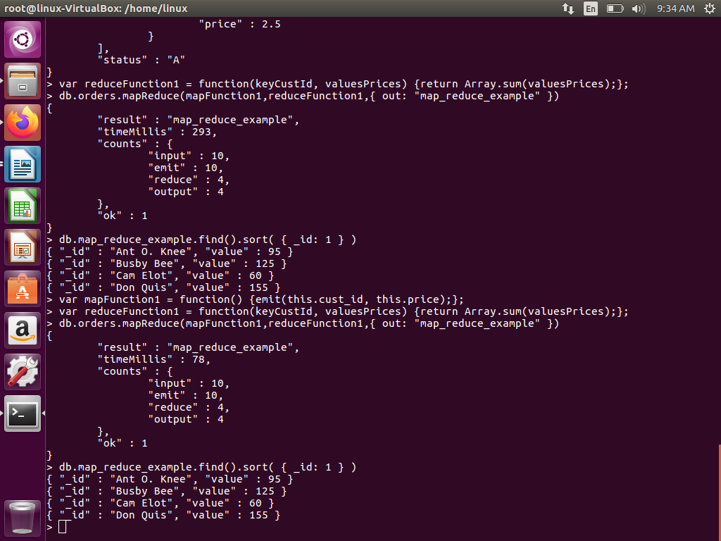

Slide 152
Single Purpose Aggregation Operations
Aggregation refers to a broad class of data manipulation operations that compute a result based on an input and a specific procedure.
MongoDB provides a number of aggregation operations that perform specific aggregation operations on a set of data.
152

Slide 153
Count
MongoDB can return a count of the number of documents that match a query. The count command as well as the count() and cursor.count() methods provide access to counts in the mongo shell.
Example
Given a collection named records with only the following documents:
{ a: 1, b: 0 }
{ a: 1, b: 1 }
{ a: 1, b: 4 }
{ a: 2, b: 2 }
The following operation would count all documents in the collection and return the number 4:
db.records.count()
The following operation will count only the documents where the value of the field a is 1 and return 3:
db.records.count( { a: 1 } )
153

Slide 154
Distinct
The distinct operation takes a number of documents that match a query and returns all of the unique values for a field in the matching documents.
The distinct command and db.collection.distinct() method provide this operation in the mongo shell.
Example of a distinct operation:
154

Slide 155
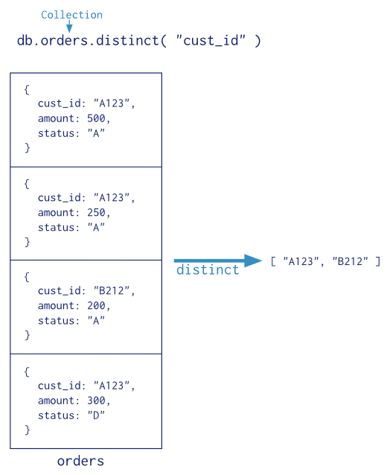
155

Slide 156
Example
Given a collection named records with only the following documents:
{ a: 1, b: 0 }
{ a: 1, b: 1 }
{ a: 1, b: 1 }
{ a: 1, b: 4 }
{ a: 2, b: 2 }
{ a: 2, b: 2 }
db.records.distinct( "b" )
Output:[ 0, 1, 4, 2 ]
156

Slide 157
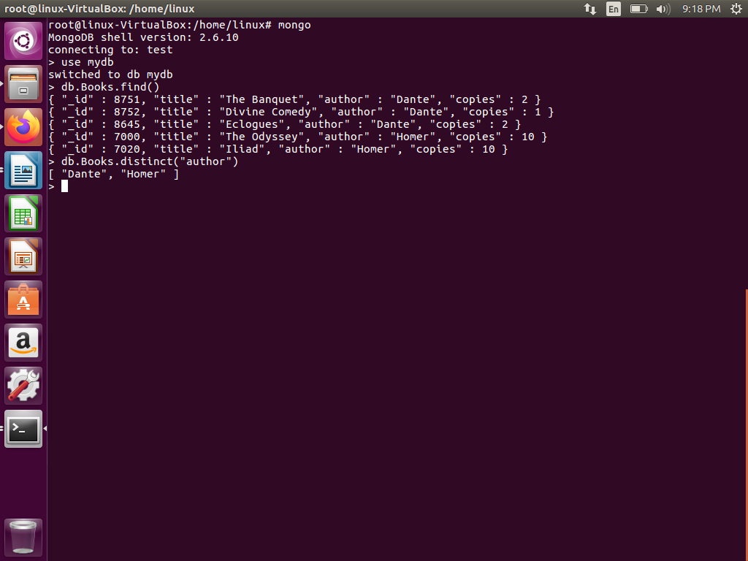

Slide 158
Group
The group operation takes a number of documents that match a query, and then collects groups of documents based on the value of a field or fields.
It returns an array of documents with computed results for each group of documents.
Access the grouping functionality via the group command or the db.collection.group() method in the mongo shell.
158

Slide 159
Groups documents in a collection by the specified keys and performs simple aggregation functions such as computing counts and sums.
The method is analogous to a SELECT <...> GROUP BY statement in SQL.
The group() method returns an array.
Definition
db.collection.group({ key, reduce, initial, [keyf,] [cond,] finalize })
159

Slide 160
Field | Type | Description
key | document | The field or fields to group. Returns a “key object” for use as the grouping key.
reduce | function | An aggregation function that operates on the documents during the grouping operation. These functions may return a sum or a count. The function takes two arguments: the current document and an aggregation result document for that group.
initial | document | Initializes the aggregation result document.
160

Slide 161
keyf | function | Optional. Alternative to the key field. Specifies a function that creates a “key object” for use as the grouping key. Use keyf instead of key to group by calculated fields rather than existing document fields.
cond | document | Optional. The selection criteria to determine which documents in the collection to process. If you omit the cond field, db.collection.group() processes all the documents in the collection for the group operation.
finalize | function | Optional. A function that runs each item in the result set before db.collection.group() returns the final value. This function can either modify the result document or replace the result document as a whole.
ns | string | The collection from which to perform the group by operation.
161

Slide 162
The db.collection.group() method is a shell wrapper for the group command.
However, the db.collection.group() method takes the keyf field and the reduce field whereas the group command takes the $keyf field and the $reduce field.
162

Slide 163
Example
Given a collection named records with the following documents:
{ a: 1, count: 4 }
{ a: 1, count: 2 }
{ a: 1, count: 4 }
{ a: 2, count: 3 }
{ a: 2, count: 1 }
{ a: 1, count: 5 }
{ a: 4, count: 4 }
163

Slide 164
Following group operation groups documents by the field a, where a is less than 3, and sums the field count for each group:
db.records.group(
{
key: { a: 1 },
cond: { a: { $lt: 3 } },
reduce: function(cur, result)
{
result.count += cur.count },
initial: { count: 0 }
}
)
Output: [ { a: 1, count: 15 }, { a: 2, count: 4 } ]
164

Slide 165
Group command:
Groups documents in a collection by the specified key and performs simple aggregation functions, such as computing counts and sums.
The command is analogous to a SELECT <...> GROUP BY statement in SQL.
The command returns a document with the grouped records.
165

Slide 166
Syntax:
{ group:
{ ns: <namespace>,
key: <key>,
$reduce: <reduce function>,
$keyf: <key function>,
cond: <query>,
finalize: <finalize function>
}
}
166

Slide 167
Group by Two Fields
The following example groups by the ord_dt and item.sku fields those documents that have ord_dt greater than 01/07/2015:
db.runCommand(
{ group:
{
ns: 'orders',
key: { ord_dt: 1, 'item.sku': 1 },
cond: { ord_dt:
{ $gt: new Date( ‘01/07/2015' ) }}, $reduce: function ( curr, result ) { },
initial: { }
}
}
)
167

Slide 168
db.runCommand() runs the command in the context of the current database. Some commands are only applicable in the context of the admin database, and you must change your db object to before running these commands.
The method call is analogous to the SQL statement:
SELECT ord_dt, item_sku
FROM orders
WHERE ord_dt > ‘01/07/2014’
GROUP BY ord_dt, item_sku
168

Slide 169
{ "_id" : 1, "domainName" : "test1.com", "hosting" : "hostgator.com" }
{ "_id" : 2, "domainName" : "test2.com", "hosting" : "aws.amazon.com"}
{ "_id" : 3, "domainName" : "test3.com", "hosting" : "aws.amazon.com" }
{ "_id" : 4, "domainName" : "test4.com", "hosting" : "hostgator.com" }
{ "_id" : 5, "domainName" : "test5.com", "hosting" : "aws.amazon.com" }
{ "_id" : 6, "domainName" : "test6.com", "hosting" : "cloud.google.com" }
{ "_id" : 7, "domainName" : "test7.com", "hosting" : "aws.amazon.com" }
{ "_id" : 8, "domainName" : "test8.com", "hosting" : "hostgator.com" }
{ "_id" : 9, "domainName" : "test9.com", "hosting" : "cloud.google.com" }
{ "_id" : 10, "domainName" : "test10.com", "hosting" : "godaddy.com" }
169

Slide 170
The following example groups by the “hosting” field, and display the total sum of each hosting.
> db.website.aggregate(
{
$group : {_id : "$hosting", total : { $sum : 1 } }
}
);
Equivalent query in SQL:-
SELECT hosting, SUM(hosting) AS total
FROM website
GROUP BY hosting
170

Slide 171
{ "result" :
[
{ "_id" : "godaddy.com", "total" : 1 },
{ "_id" : "cloud.google.com", "total" : 2 },
{ "_id" : "aws.amazon.com", "total" : 4 },
{ "_id" : "hostgator.com", "total" : 3 }
],
"ok" : 1
}
171

Slide 172
MongoDB Indexing
Indexes support the efficient execution of queries. Without indexes, MongoDB must scan every document of a collection to select those documents that match the query statement. This scan is highly inefficient and require the mongod to process a large volume of data.
Indexes are special data structures.
The index stores the value of a specific field or set of fields, ordered by the value of the field as specified in index.
Indexes in MongoDB are similar to indexes in other database systems. MongoDB defines indexes at the collection level and supports indexes on any field or sub-field of the documents in a MongoDB collection.
172

Slide 173
Index Types
MongoDB provides a number of different index types.
You can create indexes on any field or embedded field within a document or sub-document.
MongoDB also supports indexes of arrays, called multi-key indexes, single field indexes or compound indexes .
In the mongo shell, you can create an index by calling the ensureIndex() method.
173

Slide 174
MongoDB indexes may be ascending, (i.e. 1) or descending
(i.e. -1) in their ordering.
MongoDB indexes use a B-tree data structure.
Single Field Indexes
Example
Consider friends collection:
{ "_id" : ObjectId(...), "name" : "Alice" "age" : 27 }
The following command creates an index on the name field:
db.friends.ensureIndex( { "name" : 1 } )
174

Slide 175
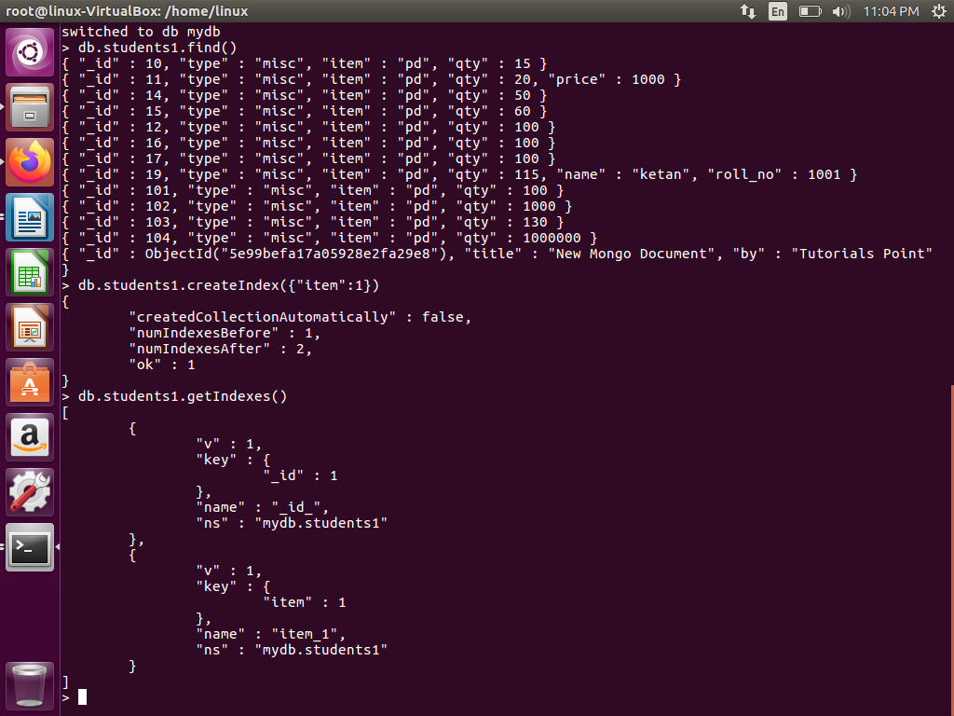

Slide 176
Indexes on Embedded Fields
You can create indexes on fields embedded in sub-documents.
Indexes on embedded fields differ from indexes on sub-documents, which include the full content up to the maximum index size of the sub-document in the index.
Consider a collection named people that holds documents that resemble the following example document:
176

Slide 177
{
"_id": ObjectId(...)
"name": "John "
"address":
{ "street": "Main",
"zipcode": "53511",
"state": "WI"
}
}
You can create an index on the address.zipcode field, using the following specification:
db.people.ensureIndex( { "address.zipcode": 1 } )
177

Slide 178
Indexes on Subdocuments
For example, the factories collection contains documents that contain a metro field, such as:
{
_id: ObjectId(...),
metro: { city: "New York",
state: "NY" },
name: "Giant Factory"
}
The metro field is a subdocument, containing the embedded fields city and state. The following command creates an index on the metro field as a whole:
db.factories.ensureIndex( { metro: 1 } )
178

Slide 179
The following query can use the index on the metro field:
db.factories.find(
{ metro:
{ city: "New York",
state: "NY"
}
} )
This query returns the above document. When performing equality matches on subdocuments, field order matters and the subdocuments must match exactly. For example, the following query does not match the above document:
db.factories.find( { metro: { state: "NY", city: "New York" } } )
179

Slide 180
The ensureIndex() Method
SYNTAX:
>db.COLLECTION_NAME.ensureIndex({KEY:1})
Here key is the name of field on which you want to create index and 1 is for ascending order. To create index in descending order you need to use -1.
EXAMPLE
>db.mycol.ensureIndex({"title":1})
In ensureIndex() method you can pass multiple fields, to create index on multiple fields.
>db.mycol.ensureIndex({"title":1,"description":-1})
180

Slide 181
Compound Indexes
MongoDB supports compound indexes, where a single index structure holds references to multiple fields within a collection’s documents.
MongoDB supports indexes that include content on a single field, as well as compound indexes that include content from multiple fields.
Build a Compound Index
db.collection.ensureIndex( { a: 1, b: 1, c: 1 } )
181

Slide 182
The value of the field in the index specification describes the kind of index for that field.
For example, a value of 1 specifies an index that orders items in ascending order. A value of -1 specifies an index that orders items in descending order.
Example
The following operation will create an index on the item, category, and price fields of the products collection:
db.products.ensureIndex( { item: 1, category: 1, price: 1 } )
Compound indexes can support queries that match on multiple fields.
182

Slide 183
Sort Order
Indexes store references to fields in either ascending (1) or descending (-1) sort order.
For single-field indexes, the sort order of keys doesn’t matter because MongoDB can traverse the index in either direction. However, for compound indexes, sort order can matter in determining whether the index can support a sort operation.
Consider a collection events that contains documents with the fields username and date. Applications can issue queries that return results sorted first by ascending username values and then by descending (i.e. more recent to last) date values, such as:
db.events.find().sort( { username: 1, date: -1 } )
183

Slide 184
or queries that return results sorted first by descending username values and then by ascending date values, such as:
db.events.find().sort( { username: -1, date: 1 } )
The following index can support both these sort operations:
db.events.ensureIndex( { "username" : 1, "date" : -1 } )
However, the above index cannot support sorting by ascending username values and then by ascending date values, such as the following:
db.events.find().sort( { username: 1, date: 1 } )
184

Slide 185
Multikey Indexes
To index a field that holds an array value, MongoDB adds index items for each item in the array.
These multikey indexes allow MongoDB to return documents from queries using the value of an array.
MongoDB automatically determines whether to create a multikey index if the indexed field contains an array value; you do not need to explicitly specify the multikey type.
185

Slide 186
Limitations
Interactions between Compound and Multikey Indexes
While you can create multikey compound indexes, at most one field in a compound index may hold an array.
For example, given an index on { a: 1, b: 1 }, the following documents are permissible:
{a: [1, 2], b: 1} {a: 1, b: [1, 2]}
186

Slide 187
However, the following document is impermissible, and MongoDB cannot insert such a document into a collection with the {a: 1, b: 1 } index:
{a: [1, 2], b: [1, 2]}
If you attempt to insert such a document, MongoDB will reject the insertion, and produce an error that says cannot index parallel arrays.
MongoDB does not index parallel arrays because they require the index to include each value in the Cartesian product of the compound keys, which could quickly result in incredibly large and difficult to maintain indexes.
187

Slide 188
Examples
Index Basic Arrays
Given the following document:
{ "_id" : ObjectId("..."),
"name" : "Warm Weather",
"author" : "Steve",
"tags" : [ "weather", "hot", "record", "april" ]
}
188

Slide 189
Then an index on the tags field, { tags: 1 }, would be a multikey index and would include these four separate entries for that document:
"weather",
"hot",
"record", and
"april".
Queries could use the multikey index to return queries for any of the above values.
189

Slide 190
Index Arrays with Embedded Documents
You can create multikey indexes on fields in objects embedded in arrays, as in the following example:
Consider a feedback collection with documents in the following form:
{ "_id": ObjectId(...),
"title": "Grocery Quality",
"comments": [ { author_id: ObjectId(...),
date: Date(...),
text: "Please expand the selection."
},
190

Slide 191
{ author_id: ObjectId(...),
date: Date(...),
text: "Please expand the mustard selection."
},
{ author_id: ObjectId(...),
date: Date(...),
text: "Please expand the olive selection."
}
]
}
An index on the comments.text field would be a multikey index and would add items to the index for all embedded documents in the array.
191

Slide 192
With the index { "comments.text": 1 } on the feedback collection, consider the following query:
db.feedback.find(
{ "comments.text": "Please expand the olive selection." } )
The query would select the documents in the collection that contain the following embedded document in the comments array:
{
author_id: ObjectId(...),
date: Date(...),
text: "Please expand the olive selection."
}
192

Slide 193
Array of Embedded Documents
Consider that the inventory collection includes the following documents:
{
_id: 100,
type: "food",
item: "xyz",
qty: 25,
price: 2.5,
ratings: [ 5, 8, 9 ],
memos: [ { memo: "on time", by: "shipping" },
{ memo: "approved", by: "billing" } ]
}
193

Slide 194
{
_id: 101,
type: "fruit",
item: "jkl",
qty: 10,
price: 4.25,
ratings: [ 5, 9 ],
memos: [ { memo: "on time", by: "payment" },
{ memo: "delayed", by: "shipping" }
]
}
194

Slide 195
Match a Field in the Embedded Document Using the Array Index
If you know the array index of the embedded document, you can specify the document using the subdocument’s position using the dot notation.
The following example selects all documents where the memos contains an array whose first element (i.e. index is 0) is a document that contains the field by whose value is ‘shipping’:
db.inventory.find( { 'memos.0.by': 'shipping' } )
195

Slide 196
The operation returns the following document:
{
_id: 100,
type: "food",
item: "xyz",
qty: 25,
price: 2.5,
ratings: [ 5, 8, 9 ],
memos: [ { memo: "on time", by: "shipping" },
{ memo: "approved", by: "billing" }
]
}
196

Slide 197
Match a Field Without Specifying Array Index
If you do not know the index position of the document in the array, concatenate the name of the field that contains the array, with a dot (.) and the name of the field in the subdocument.
The following example selects all documents where the memos field contains an array that contains at least one embedded document that contains the field by with the value ‘shipping’:
db.inventory.find( { 'memos.by': 'shipping' } )
197

Slide 198
The operation returns the following documents:
{
_id: 100,
type: "food",
item: "xyz",
qty: 25,
price: 2.5,
ratings: [ 5, 8, 9 ],
memos: [ { memo: "on time", by: "shipping" }, { memo: "approved", by: "billing" } ]
}
{
_id: 101,
type: "fruit",
item: "jkl",
qty: 10,
price: 4.25,
ratings: [ 5, 9 ],
memos: [ { memo: "on time", by: "payment" }, { memo: "delayed", by: "shipping" } ]
}
198

Slide 199
Create a Unique Index
MongoDB allows you to specify a unique constraint on an index. These constraints prevent applications from inserting documents that have duplicate values for the inserted fields.
Additionally, if you want to create an index on a collection that has existing data that might have duplicate values for the indexed field, then use duplicate dropping.
Unique Indexes
To create a unique index, consider the following prototype:
db.collection.ensureIndex( { a: 1 }, { unique: true } )
199

Slide 200
For example, you may want to create a unique index on the "tax-id": of the accounts collection to prevent storing multiple account records for the same legal entity:
db.accounts.ensureIndex( { "tax-id": 1 }, { unique: true } )
200

Slide 201
Unique Constraint Across Separate Documents
The unique constraint applies to separate documents in the collection.
That is, the unique index prevents separate documents from having the same value for the indexed key, but the index does not prevent a document from having multiple elements or embedded documents in an indexed array from having the same value.
In the case of a single document with repeating values, the repeated value is inserted into the index only once.
201

Slide 202
For example, a collection has a unique index on a.b:
db.collection.ensureIndex( { "a.b": 1 }, { unique: true } )
The unique index permits the insertion of the following document into the collection if no other document in the collection has the a.b value of 5:
db.collection.insert( { a: [ { b: 5 }, { b: 5 } ] } )
202

Slide 203
Drop Duplicates
MongoDB cannot create a unique index on a field that has duplicate values.
To force the creation of a unique index, you can specify the dropDups option, which will only index the first occurrence of a value for the key, and delete all subsequent values.
203

Slide 204
To create an unique index that drops duplicates on the username field of the accounts collection, use a command in the following form:
db.accounts.ensureIndex(
{ username: 1 },
{ unique: true,
dropDups: true }
)
Specifying { dropDups: true } will delete data from your database.
By default, dropDups is false.
204

Slide 205
Index Names
The default name for an index is the concatenation of the indexed keys and each key’s direction in the index, 1 or -1.
Example
Consider the following command to create an index on item and quantity:
db.products.ensureIndex( { item: 1, quantity: -1 } )
The resulting index is named: item_1_quantity_-1.
Optionally, you can specify a name for an index instead of using the default name.
205

Slide 206
Example
Issue the following command to create an index on item and quantity and specify inventory as the index name:
db.products.ensureIndex(
{ item: 1, quantity: -1 } ,
{ name: "inventory" }
)
The resulting index has the name inventory.
To view the name of an index, use the getIndexes() method.
206

Slide 207
Create a Sparse Index
Sparse omit references to documents that do not include the indexed field. For fields that are only present in some documents sparse indexes may provide a significant space savings.
To create a sparse index on a field, use following operation
db.collection.ensureIndex( { a: 1 }, { sparse: true } )
207

Slide 208
Example
The following operation, creates a sparse index on the users collection that only includes a document in the index if the twitter_name field exists in a document.
db.users.ensureIndex(
{ twitter_name: 1 }, { sparse: true } )
The index excludes all documents that do not include the twitter_name field.
208

Slide 209
Example:Create a Sparse Index On A Collection
Consider a collection scores that contains the following documents:
{ "_id" : ObjectId("523b6e32fb408eea0eec2647"),
"userid" : “abc”
}
{ "_id" : ObjectId("523b6e61fb408eea0eec2648"),
"userid" : “xyz",
"score" : 82 }
{ "_id" : ObjectId("523b6e6ffb408eea0eec2649"),
"userid" : “lmn",
"score" : 90
}
The collection has a sparse index on the field score:
db.scores.ensureIndex( { score: 1 } , { sparse: true } )
209

Slide 210
Then, the following query on the scores collection uses the sparse index to return the documents that have the score field less than ($lt) 90:
db.scores.find( { score: { $lt: 90 } } )
Because the document for the userid “abc" does not contain the score field and thus does not meet the query criteria, the query can use the sparse index to return the results:
{ "_id" : ObjectId("523b6e61fb408eea0eec2648"),
"userid" : “xyz",
"score" : 82 }
210

Slide 211
Sparse Index On A Collection Cannot Return Complete Results
Consider a collection scores that contains the following documents:
{ "_id" : ObjectId("523b6e32fb408eea0eec2647"), "userid" : “abc”
}
{ "_id" : ObjectId("523b6e61fb408eea0eec2648"), "userid" : “xyz", "score" : 82 }
{ "_id" : ObjectId("523b6e6ffb408eea0eec2649"), "userid" : “lmn", "score" : 90 }
211

Slide 212
The collection has a sparse index on the field score:
db.scores.ensureIndex( { score: 1 } , { sparse: true } )
Because the document for the userid “abc" does not contain the score field, the sparse index does not contain an entry for that document.
212

Slide 213
To use the sparse index, explicitly specify the index with hint():
db.scores.find().sort( { score: -1 } ).hint( { score: 1 } )
The use of the index results in the return of only those documents with the score field:
{ "_id" : ObjectId("523b6e6ffb408eea0eec2649"), "userid" : “lmn", "score" : 90
}
{ "_id" : ObjectId("523b6e61fb408eea0eec2648"), "userid" : “xyz”, "score" : 82
}
213

Slide 214
Consider the following operation:
db.users.find().hint( { score: 1 } )
This operation returns all documents in the collection named users using the index on the score field.
214

Slide 215
Sparse Index with Unique Constraint
Consider a collection scores that contains the following documents:
{ "_id" : ObjectId("523b6e32fb408eea0eec2647"),
"userid" : "newbie"
}
{ "_id" : ObjectId("523b6e61fb408eea0eec2648"),
"userid" : "abby", "score" : 82
}
{ "_id" : ObjectId("523b6e6ffb408eea0eec2649"),
"userid" : "nina", "score" : 90 }
You could create an index with a unique constraint and sparse filter on the score field using the following operation:
db.scores.ensureIndex( { score: 1 } , { sparse: true, unique: true } )
215

Slide 216
This index would permit the insertion of documents that had unique values for the score field or did not include a score field.
Consider the following insert operation:
db.scores.insert( { "userid": "AAAAAAA", "score": 43 } ) db.scores.insert( { "userid": "BBBBBBB", "score": 34 } ) db.scores.insert( { "userid": "CCCCCCC" } )
db.scores.insert( { "userid": "DDDDDDD" } )
However, the index would not permit the addition of the following documents since documents already exists with score value of 82 and 90:
db.scores.insert( { "userid": "AAAAAAA", "score": 82 } ) db.scores.insert( { "userid": "BBBBBBB", "score": 90 } )
216

Slide 217
Create a Hashed Index
Hashed indexes compute a hash of the value of a field in a collection and index the hashed value.
MongoDB automatically computes the hashes when resolving queries using hashed indexes. Applications do not need to compute hashes.
MongoDB supports hashed indexes of any single field.
The hashing function collapses embedded documents and computes the hash for the entire value, but does not support multi-key (i.e. arrays) indexes.
217

Slide 218
Hashed indexes maintain entries with hashes of the values of the indexed field.
To create a hashed index, specify hashed as the value of the index key, as in the following example:
Example
Specify a hashed index on _id
db.collection.ensureIndex( { _id: "hashed" } )
218

Slide 219
END
219

Slide 220
MongoDB Java
Installation
Before we start using MongoDB in our Java programs, we need to make sure that we have MongoDB JDBC Driver and Java set up on the machine.
You need to download the jar file(Download mongo.jar). Make sure to download latest release of it.
You need to include the mongo.jar into your classpath.
Connect to database
To connect database, you need to specify database name, if database doesn't exist then mongodb creates it automatically.
220

Slide 221
import com.mongodb.MongoClient;
import com.mongodb.MongoException;
import com.mongodb.WriteConcern;
import com.mongodb.DB;
import com.mongodb.DBCollection;
import com.mongodb.BasicDBObject;
import com.mongodb.DBObject;
import com.mongodb.DBCursor;
import com.mongodb.ServerAddress;
import java.util.Arrays;
public class MongoDBJDBC
{
public static void main( String args[] )
{
try
{ // To connect to mongodb server
MongoClient mongoClient = new MongoClient( "localhost" , 27017 );
221

Slide 222
// Now connect to your databases
DB db = mongoClient.getDB( "test" );
System.out.println("Connect to database successfully");
boolean auth = db.authenticate(myUserName, myPassword);
System.out.println("Authentication: "+auth); }
catch(Exception e)
{
System.err.println( e.getClass().getName() + ": " + e.getMessage() );
}
}
}
222

Slide 223
Now, let's compile and run above program to create our database test. You can change your path as per your requirement.
$javac MongoDBJDBC.java
$java -classpath ".:mongo-2.10.1.jar" MongoDBJDBC
Connect to database successfully
Authentication: true
223

Slide 224
The MongoClient instance actually represents a pool of connections to the database; you will only need one instance of class MongoClient even with multiple threads.
To dispose of an instance,call MongoClient.close() to clean up resources.
224

Slide 225
Authentication (Optional)
MongoDB can be run in a secure mode where access to databases is controlled through name and password authentication. When run in this mode, any client application must provide a name and password before doing any operations.
In the Java driver, following steps are considered with a MongoClient instance:
MongoClient mongoClient = new MongoClient();
DB db = mongoClient.getDB("test");
boolean auth = db.authenticate(myUserName, myPassword);
If the name and password are valid for the database, auth will be true. Otherwise, it will be false.
225

Slide 226
Getting a List Of Collections
Each database has zero or more collections. You can retrieve a list of them from the db.:
Set<String> colls = db.getCollectionNames();
for (String s : colls)
{
System.out.println(s);
}
and assuming that there are two collections, name and address, in the database, you would see
name
address
as the output.
226

Slide 227
Getting a Collection
To get a collection to use, specify the name of the collection to the getCollection(String collectionName) method:
DBCollection coll = db.getCollection("testCollection");
227

Slide 228
Inserting a Document
Once you have the collection object, you can insert documents into the collection.
For example,
{
"name" : "MongoDB",
"type" : "database",
"count" : 1,
"info" :
{ x : 203,
y : 102
}
}
228

Slide 229
The above has an “inner” document embedded within it.
To do this, we can use the BasicDBObject class to create the document (including the inner document), and then just simply insert it into the collection using the insert() method.
BasicDBObject doc = new BasicDBObject("name", "MongoDB")
.append("type", "database")
.append("count", 1)
.append("info", new BasicDBObject("x", 203)
.append("y", 102)
);
coll.insert(doc);
229

Slide 230
Finding the First Document in a Collection Using findOne()
To show that the document we inserted in the previous step is there, we can do a simple findOne() operation to get the first document in the collection.
This method returns a single document.
230

Slide 231
DBObject myDoc = coll.findOne();
System.out.println(myDoc);
Output:
{ "_id" : "49902cde5162504500b45c2c" ,
"name" : "MongoDB" ,
"type" : "database" ,
"count" : 1 ,
"info" : { "x" : 203 , "y" : 102}
}
231

Slide 232
Adding Multiple Documents
These documents will just be { "i" : value } and we can do this in a loop
for (int i=0; i < 100; i++)
{
coll.insert(new BasicDBObject("i", i));
}
We can insert documents of different “shapes” into the same collection-MongoDB is “schema-free”
232

Slide 233
Counting Documents in a Collection
System.out.println(coll.getCount());
and it should print 100.
233

Slide 234
Using a Cursor to Get All the Documents
In order to get all the documents in the collection, we will use the find() method. The find() method returns a DBCursor object which allows us to iterate over the set of documents that matched our query. So to query all of the documents and print them out :
DBCursor cursor = coll.find();
try
{ while(cursor.hasNext())
{ System.out.println(cursor.next());
}
}
finally
{ cursor.close(); }
and that should print all 100 documents in the collection.
234

Slide 235
Getting A Single Document with A Query
We can create a query to pass to the find() method to get a subset of the documents in our collection.
For example, if we wanted to find the document for which the value of the “i” field is 72, consider following :
BasicDBObject query = new BasicDBObject("i", 72);
cursor = coll.find(query);
try
{ while(cursor.hasNext())
{
System.out.println(cursor.next());
}
}
finally { cursor.close(); }
235

Slide 236
and it should just print just one document
{ "_id" : "49903677516250c1008d624e" , "i" : 72 }
Consider following:
db.things.find(
{
j: {$ne: 3},
k: {$gt: 10}
}
);
236

Slide 237
These are represented as regular String keys in the Java driver, using embedded DBObjects:
query = new BasicDBObject("j", new BasicDBObject("$ne", 3)) .append("k", new BasicDBObject("$gt", 10));
cursor = coll.find(query);
237

Slide 238
try
{
while(cursor.hasNext())
{
System.out.println(cursor.next());
}
}
finally
{
cursor.close();
}
238

Slide 239
Getting A Set of Documents With a Query
We can use the query to get a set of documents from our collection. For example, if we wanted to get all documents where "i" > 50, we could write:
// find all where i > 50
query = new BasicDBObject("i", new BasicDBObject("$gt", 50)); cursor = coll.find(query);
try
{
while (cursor.hasNext())
{ System.out.println(cursor.next()); }
}
finally { cursor.close(); }
239

Slide 240
which should print the documents where i > 50.
We could also get a range, say 20 < i <= 30:
query = new BasicDBObject("i", new BasicDBObject
("$gt”, 20)
.append("$lte", 30)
);
cursor = testCollection.find(query);
try
{
while (cursor.hasNext())
{ System.out.println(cursor.next()); }
}
finally { cursor.close(); }
240

Slide 241
Getting A List of Databases
You can get a list of the available databases:
MongoClient mongoClient = new MongoClient();
for (String s : mongoClient.getDatabaseNames())
{
System.out.println(s);
}
241

Slide 242
Dropping A Database
You can drop a database by name using a MongoClient instance:
MongoClient mongoClient = new MongoClient();
mongoClient.dropDatabase("databaseToBeDropped");
242

Slide 243
Creating A Collection
There are two ways to create a collection.
Inserting a document will create the collection if it doesn’t exist or calling the createCollection command.
An example of creating a capped sized to 1 megabyte:
db = mongoClient.getDB("mydb");
db.createCollection("testCollection",
new BasicDBObject("capped", true) .append("size", 1048576)
);
243

Slide 244
Getting A List of Collections
You can get a list of the available collections in a database:
for (String s : db.getCollectionNames())
{
System.out.println(s);
}
It should output
system.indexes
test Collection
244

Slide 245
Dropping A Collection
You can drop a collection by using the drop() method:
DBCollection test1 = db.getCollection("testCollection");
test1.drop();
System.out.println(db.getCollectionNames());
testCollection has been dropped.
245

Slide 246
Creating An Index
To create an index, you just specify the field that should be indexed, and specify if you want the index to be ascending (1) or descending (-1).
The following creates an ascending index on the i field :
coll.createIndex(new BasicDBObject("i", 1));
// create index on "i", ascending
246

Slide 247
Insert Multiple Documents Using a For Loop
You can add documents to a new or existing collection by using a JavaScript for loop run from the mongo shell.
From the mongo shell, insert new documents into the testData collection using the following for loop.
If the testData collection does not exist, MongoDB creates the collection implicitly.
for (var i = 1; i <= 25; i++)
db.testData.insert( { x : i } )
Use find() to query the collection:
db.testData.find()
247

Slide 248
Insert Multiple Documents with a mongo Shell Function
You can create a JavaScript function in your shell session to generate the above data.
The insertData() JavaScript function, creates new data for use in testing or training by either creating a new collection or appending data to an existing collection:
function insertData(dbName, colName, num)
{
var col = db.getSiblingDB(dbName).getCollection(colName);
for (i = 0; i < num; i++)
{
col.insert({x:i});
}
print(col.count());
}
248

Slide 249
The insertData() function takes three parameters: a database, a new or existing collection, and the number of documents to create.
The function creates documents with an x field that is set to an incremented integer, as in the following example documents:
{ "_id" : ObjectId("51a4da9b292904caffcff6eb"), "x" : 0 }
{ "_id" : ObjectId("51a4da9b292904caffcff6ec"), "x" : 1 }
{ "_id" : ObjectId("51a4da9b292904caffcff6ed"), "x" : 2 }
249

Slide 250
EXAMPLE
Specify database name, collection name, and the number of documents to insert as arguments to insertData().
insertData("test", "testData", 400)
This operation inserts 400 documents into the testData collection in the test database.
If the collection and database do not exist, MongoDB creates them implicitly before inserting documents.
250

Slide 251
Connect to a Database
Connect to a mongod
From a system prompt, start mongo by issuing the mongo command, as follows:
mongo
By default, mongo looks for a database server listening on port 27017 on the localhost interface. To connect to a server on a different port or interface, use the --port and --host options.
Select a Database
After starting the mongo shell the session will use the test database by default. Issue the following operation at the mongo to get the name of the current database:
db
251

Slide 252
From the mongo shell, display the list of databases, with the following operation:
show dbs
Switch to a new database named mydb, with the following operation:
use mydb
252

Slide 253
Create a Collection and Insert Documents
Insert documents into a new collection named testData within the new database named mydb.
MongoDB will create a collection implicitly upon its first use. No need to create a collection before inserting data.
Furthermore, because MongoDB uses dynamic schemas, you also need not specify the structure of your documents before inserting them into the collection.
1)From the mongo shell, confirm you are in the mydb database by issuing the following:
db
253

Slide 254
2)If mongo does not return mydb for the previous operation, set the context to the mydb database, with the following operation:
use mydb
Create two documents named j and k by using the following sequence of JavaScript operations:
j = { name : "mongo" }
k = { x : 3 }
3)Create two documents named j and k by using the following sequence of JavaScript operations:
j = { name : "mongo" }
k = { x : 3 }
254

Slide 255
4)Insert the j and k documents into the testData collection with the following sequence of operations:
db.testData.insert( j )
db.testData.insert( k )
When you insert the first document, the mongod will create both the mydb database and the testData collection.
5)Confirm that the testData collection exists. Issue the following operation:
show collections
The mongo shell will return the list of the collections in the current (i.e. mydb) database. At this point, the only collection is testData. All mongod databases also have a system.indexes collection.
6)Confirm that the documents exist in the testData collection by issuing a query on the collection using the find() method:
db.testData.find()
255

Slide 256
Output:
{ "_id" : ObjectId("4c2209f9f3924d31102bd84a"), "name" : "mongo" }
{ "_id" : ObjectId("4c2209fef3924d31102bd84b"), "x" : 3 }
All MongoDB documents must have an _id field with a unique value.
These operations do not explicitly specify a value for the _id field, so mongo creates a unique ObjectId value for the field before inserting it into the collection.
256

Slide 257
Insert Documents using a For Loop or a JavaScript Function
-Working with the Cursor
When you query a collection, MongoDB returns a “cursor” object that contains the results of the query.
The mongo shell then iterates over the cursor to display the results.
Rather than returning all results at once, the shell iterates over the cursor 20 times to display the first 20 results and then waits for a request to iterate over the remaining results. In the shell, use enter it to iterate over the next set of results.
257

Slide 258
Iterate over the Cursor with a Loop
In the MongoDB JavaScript shell, query the testData collection and assign the resulting cursor object to the c variable:
var c = db.testData.find()
Print the full result set by using a while loop to iterate over the c variable:
while ( c.hasNext() )
printjson( c.next() )
258

Slide 259
The hasNext() function returns true if the cursor has documents.
The next() method returns the next document.
The printjson() method renders the document in a JSON-like format.
The operation displays 20 documents. For example, if the documents have a single field named x, the operation displays the field as well as each document’s ObjectId:
{ "_id" : ObjectId("51a7dc7b2cacf40b79990be6"), "x" : 1 }
{ "_id" : ObjectId("51a7dc7b2cacf40b79990be7"), "x" : 2 }
{ "_id" : ObjectId("51a7dc7b2cacf40b79990be8"), "x" : 3 }
…………………
……..………….
{ "_id" : ObjectId("51a7dc7b2cacf40b79990bf9"), "x" : 20 }
259

Slide 260
Use Array Operations with the Cursor
In the mongo shell, query the testData collection and assign the resulting cursor object to the c variable:
var c = db.testData.find()
To find the document at the array index 4, use the following operation:
printjson( c [ 4 ] )
MongoDB returns the following:
{ "_id" : ObjectId("51a7dc7b2cacf40b79990bea"), "x" : 5 }
260

Slide 261
MongoDB Datatypes
String : This is most commonly used datatype to store the data.
Integer : This type is used to store a numerical value. Integer can be 32 bit or 64 bit depending upon your server.
Boolean : This type is used to store a boolean (true/ false) value.
Double : This type is used to store floating point values.
Min/ Max keys : This type is used to compare a value against the lowest and highest BSON elements.
Arrays : This type is used to store arrays or list or multiple values into one key.
Timestamp : This can be used for recording when a document has been modified or added.
261

Slide 262
Object : This datatype is used for embedded documents.
Null : This type is used to store a Null value.
Symbol : This datatype is used identically to a string however, it's generally reserved for languages that use a specific symbol type.
Date : This datatype is used to store the current date or time in UNIX time format. You can specify your own date time by creating object of Date and passing day, month, year into it.
Object ID : This datatype is used to store the document’s ID.
Binary data : This datatype is used to store binary data.
Code : This datatype is used to store javascript code into document.
262

Slide 263
References
http://docs.mongodb.org/manual/ or
SQL/XML/MongoDB (https://www.w3schools.com/)
https://www.tutorialspoint.com/mongodb/
https://www.json.org/
https://www.tutorialspoint.com/json/
263

Slide 264
END
264

